Slide 1


COFFEE SALES
George Mathew
10th September 2024

Slide 2
Outline
Executive Summary
Introduction
Methodology
Results
Conclusion

Slide 3
Executive Summary
Summary of methodologies
Data Collection through csv file downloaded using link for Exploratory Data Analysis and prediction.
Data Wrangling after converting into Pandas data frame and sampling data and dealing with Nulls. And convert certain data types.
Exploratory Data Analysis for time series analysis and specific customer purchases and preparing data for ML model to predict sales.
Machine Learning Pipeline to predict sales.
Summary of all results
Exploratory Data Analysis result
Predictive Analytics result

Slide 4
Introduction
Project background and context
This dataset contains detailed records of coffee sales from a vending machine.
The vending machine is the work of a dataset author who is committed to providing an open dataset to the community.
It is intended for analysis of purchasing patterns, sales trends, and customer preferences related to coffee products.
Data Collection Period :
The dataset spans from March 24 onwards and has captured daily transaction data.
Task - 1
Carry out Time series Exploratory Data Analysis
Task - 2
Predict Next day/week/month sales
Task - 3
Predict Specific customer purchases

Slide 5
Section 1

Slide 6
Methodology
Executive Summary
Data collection methodology:
Data was collected using the download link provided.
Perform data wrangling
Wrangling done using Sampling data and dealing with Nulls,
Perform exploratory data analysis (EDA) using matplotlib
Perform predictive analysis using linear regression models
By preprocessing, allowing us to standardize our data and train-test_split, allowing us to train split our data into training and testing data. It appears that we need to find hyperparameters and determine the model with best accuracy.

Slide 7
Data Collection and its Presentation
Data was collected using the download link provided.
Import the Libraries
Inspecting Data: Check the types and initial content.
Wrangling done using Sampling data and dealing with Nulls.
Extracting Information: Create new fields like the last four digits of the card number.
Data Type Conversion: Convert fileds viz. date and datetime fields etc. to the appropriate types.
Aggregating Data: Carry out different calculations viz. total money spent etc. for analysis.

Slide 8
EDA with Data Visualization
Bar Graphs: ​
Coffee-name-wise Sales
>> After plotting the graph, we observed that the highest sales value contribution is made by “Americano with milk’ closely followed by ‘Latte’ and then by ‘Cappuccino’, ‘Americano’, ‘Cortado’, ‘Hot Chocolate’, ‘Cocoa’ and ‘Espresso’ in that order.
The graph gives an idea of the customer preferences which can be understood better by analysing the customer-wise coffee-name preferences and the count of coffee-name-wise sales.
Coffee-name-wise number of Sales
>> After plotting the graph, we observed that the highest number of sales contribution is made by “Americano with milk’ followed by ‘Latte’ and then by ‘Cappuccino’, ‘Americano’, ‘Cortado’, ‘Hot Chocolate’, ‘Espresso’ and ‘Cocoa’ in that order.
The price of ‘Latte’ being a tad higher than ‘Americano with milk’, value wise although the ‘Latte’ comes close but number of sales-wise there is a distinct gap. Similarly, the price of ‘Cocoa’ being a higher than ‘Espresso’, value wise although the ‘Espresso’ comes after ‘Cocoa’ however, on-the-basis-of number of sales-wise the order is reversed.

Slide 9
EDA with Data Visualization
Bar Graphs: ​
Weekday-wise Sales
>> After plotting the graph for a sample period of 15th March to 21st March 2024, we observed that the highest sales value-wise was made on “Saturday’ closely followed by ‘Wednesday’ and then by ‘Tuesday’, ‘Thursday’, ‘Monday’, ‘Friday’ and ‘Sunday’ in that order.
The graph gives an idea of the days on which the sales are more. The reasons for variation which is apparently large can be understood better by analysing other parameters.
Weekday-wise Sales by Coffee type
>> After plotting the graph for a sample period of 15th March to 21st March 2024, we observed that the day-wise preferences varies as the highest number of sales contribution is made by Americano on Monday while it is by Cotrado on Saturday. And on Tuesday is Latte.
The graph gives an idea of the days on which the sales are more for a particular type of coffee. The reasons for variation can be understood better by analysing other parameters.

Slide 10
EDA with Data Visualization
Line Graphs: ​
Sales Vs Dates​
>> On observing the line plot chart, we see that it is non-linear and there is lot of variation in daily sales over the various dates. While the maximum sales on a day has been 650 (approx.), the minimum sales has been almost zero.
Sales Vs Month
>> On observing the line plot chart, we see that it is non-linear and there is lot of variation in monthly sales during various months. While the maximum sales has been in the month of May 24, the minimum sales has been in April 24.
Scatter graph: ​
Actuals Vs Predicted values​ for Next Day/Week/Month Sales AND Specific Customer Purchase
>> On observing the graph, drawn after applying the linear regression model in respect of the sales prediction for next day/week/month, we see that the points in the graph do not follow any specific pattern giving ground to a thought that the model is not a good fit.
>> On observing the graph, drawn after applying the linear regression model in respect of the specific customer-wise sales prediction for any day-of-the-week/month, we see that the points in the graph do not follow any specific pattern giving ground to a thought that the model is not a good fit.

Slide 11
Predictive Analysis
Summarize how you built and evaluated the linear regression model for Next Day/Week/Month Sales Prediction
BUILDING MODEL
Load our dataset into NumPy and Pandas
Prepare features and target
Split Data into training and testing sets
Initialize the linear regression model
Train the model on the training data
Make predictions on the test data
EVALUATING MODEL
Check accuracy for the model
Calculate Mean Squared Error (MSE) and Root Mean Squared Error (RMSE)
Perform cross-validation and Calculate mean cross-validated MSE
Plot residuals and Plot actual vs predicted values
IMPROVING MODEL
Feature Engineering
FINDING THE BEST PERFORMING CLASSIFICATION MODEL
More analysis and trying with other models after feature engineering will help find the good fit.

Slide 12
Predictive Analysis
Summarize how you built and evaluated the linear regression model for Specific Customer Purchase Prediction
BUILDING MODEL
Load our dataset into NumPy and Pandas
Prepare features and target
Split Data into training and testing sets
Initialize the linear regression model
Train the model on the training data
Make predictions on the test data
EVALUATING MODEL
Check accuracy for the model
Calculate Mean Absolute Error (MSE), Mean Squared Error (RMSE) and R square Score
Perform cross-validation and Calculate cross-validated MSE
Plot residuals and Plot actual vs predicted values
IMPROVING MODEL
Feature Engineering
FINDING THE BEST PERFORMING CLASSIFICATION MODEL
More analysis and trying with other models after feature engineering will help find the good fit.

Slide 13
Results
Exploratory data analysis results
Predictive analysis results

Slide 14
Section 2

Slide 15
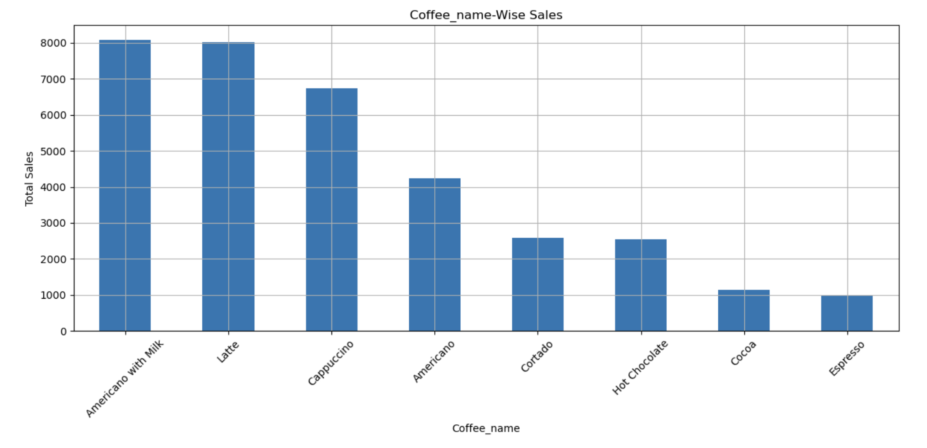
Bar Graph :
Bar graph of Coffee-name-wise Sales
EXPLANATION
>> After plotting the graph, we observed that the highest sales value contribution is made by “Americano with milk’ closely followed by ‘Latte’ and then by ‘Cappuccino’, ‘Americano’, ‘Cortado’, ‘Hot Chocolate’, ‘Cocoa’ and ‘Espresso’ in that order.
The graph gives an idea of the customer preferences which can be understood better by analysing the customer-wise coffee-name preferences and the count of coffee-name-wise sales.

Slide 16
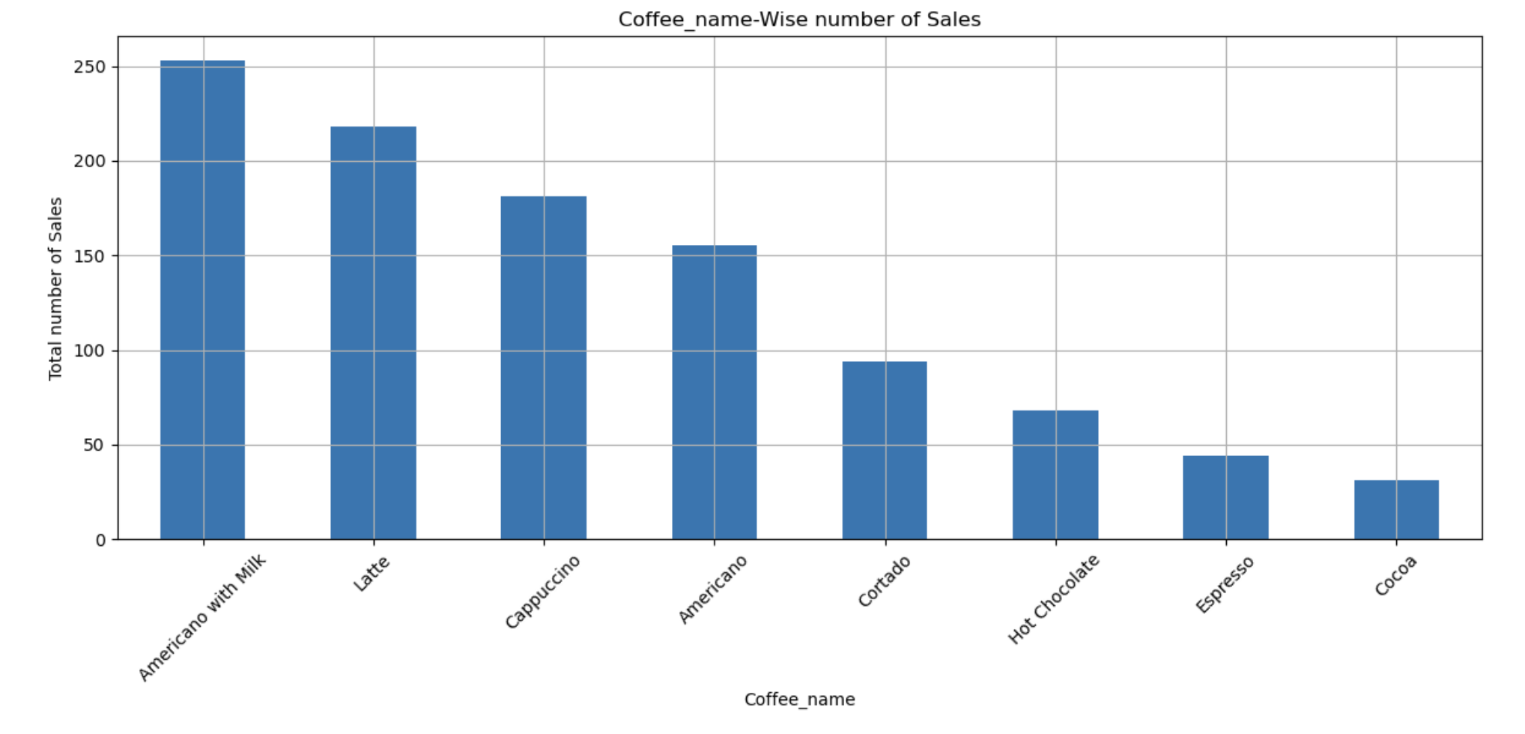
Bar Graph :
Bar graph of Coffee-name-wise number of Sales
EXPLANATION
>> After plotting the graph, we observed that the highest number of sales contribution is made by “Americano with milk’ followed by ‘Latte’ and then by ‘Cappuccino’, ‘Americano’, ‘Cortado’, ‘Hot Chocolate’, ‘Espresso’ and ‘Cocoa’ in that order.
The price of ‘Latte’ being a tad higher than ‘Americano with milk’, value wise although the ‘Latte’ comes close but number of sales-wise there is a distinct gap. Similarly, the price of ‘Cocoa’ being a higher than ‘Espresso’, value wise although the ‘Espresso’ comes after ‘Cocoa’ however, on-the-basis-of number of sales-wise the order is reversed.

Slide 17
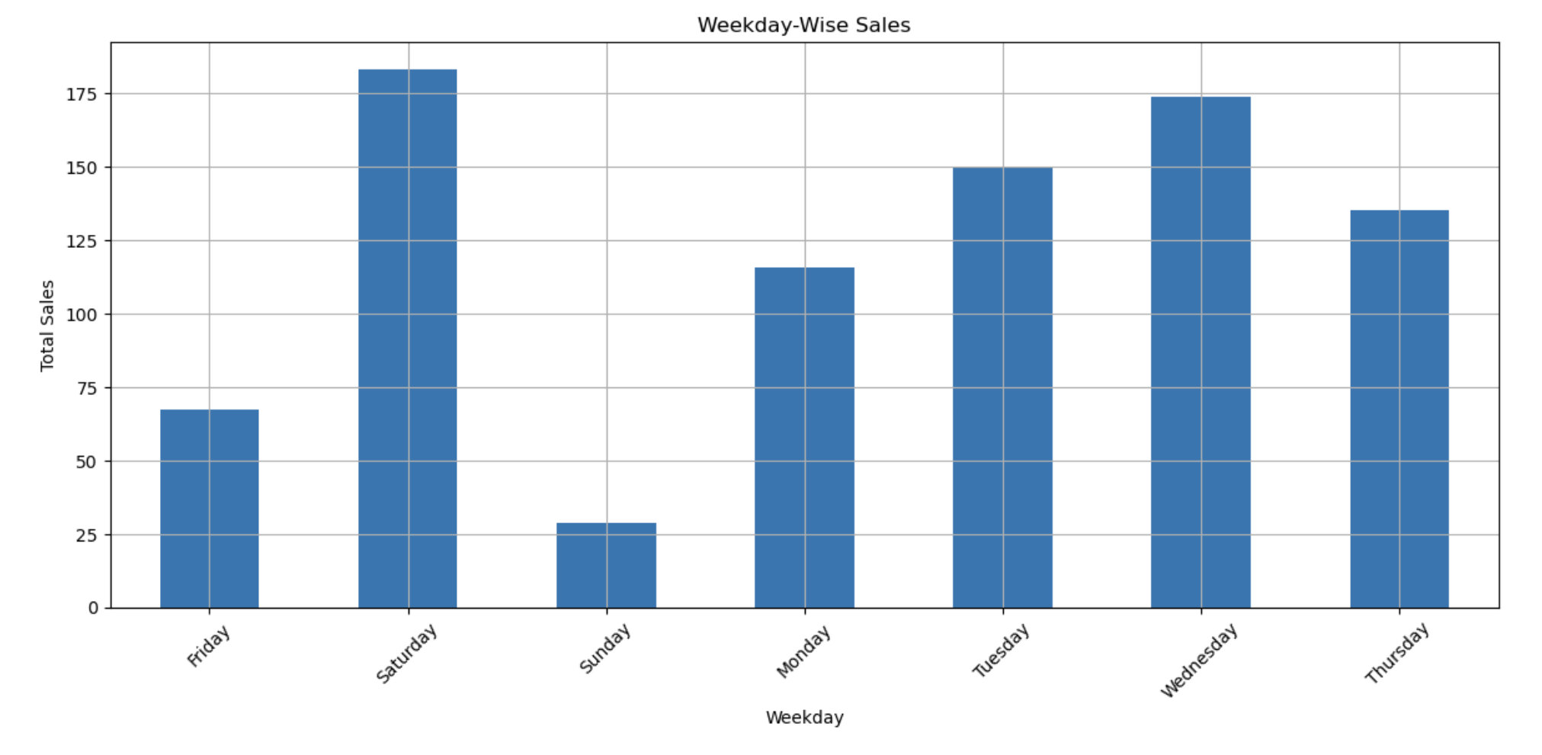
Bar Graph :
Bar graph of Weekday-wise Sales
EXPLANATION
>> After plotting the graph for a sample period of 15th March to 21st March 2024, we observed that the highest sales value-wise was made on “Saturday’ closely followed by ‘Wednesday’ and then by ‘Tuesday’, ‘Thursday’, ‘Monday’, ‘Friday’ and ‘Sunday’ in that order.
The graph gives an idea of the days on which the sales are more. The reasons for variation which is apparently large can be understood better by analysing other parameters

Slide 18
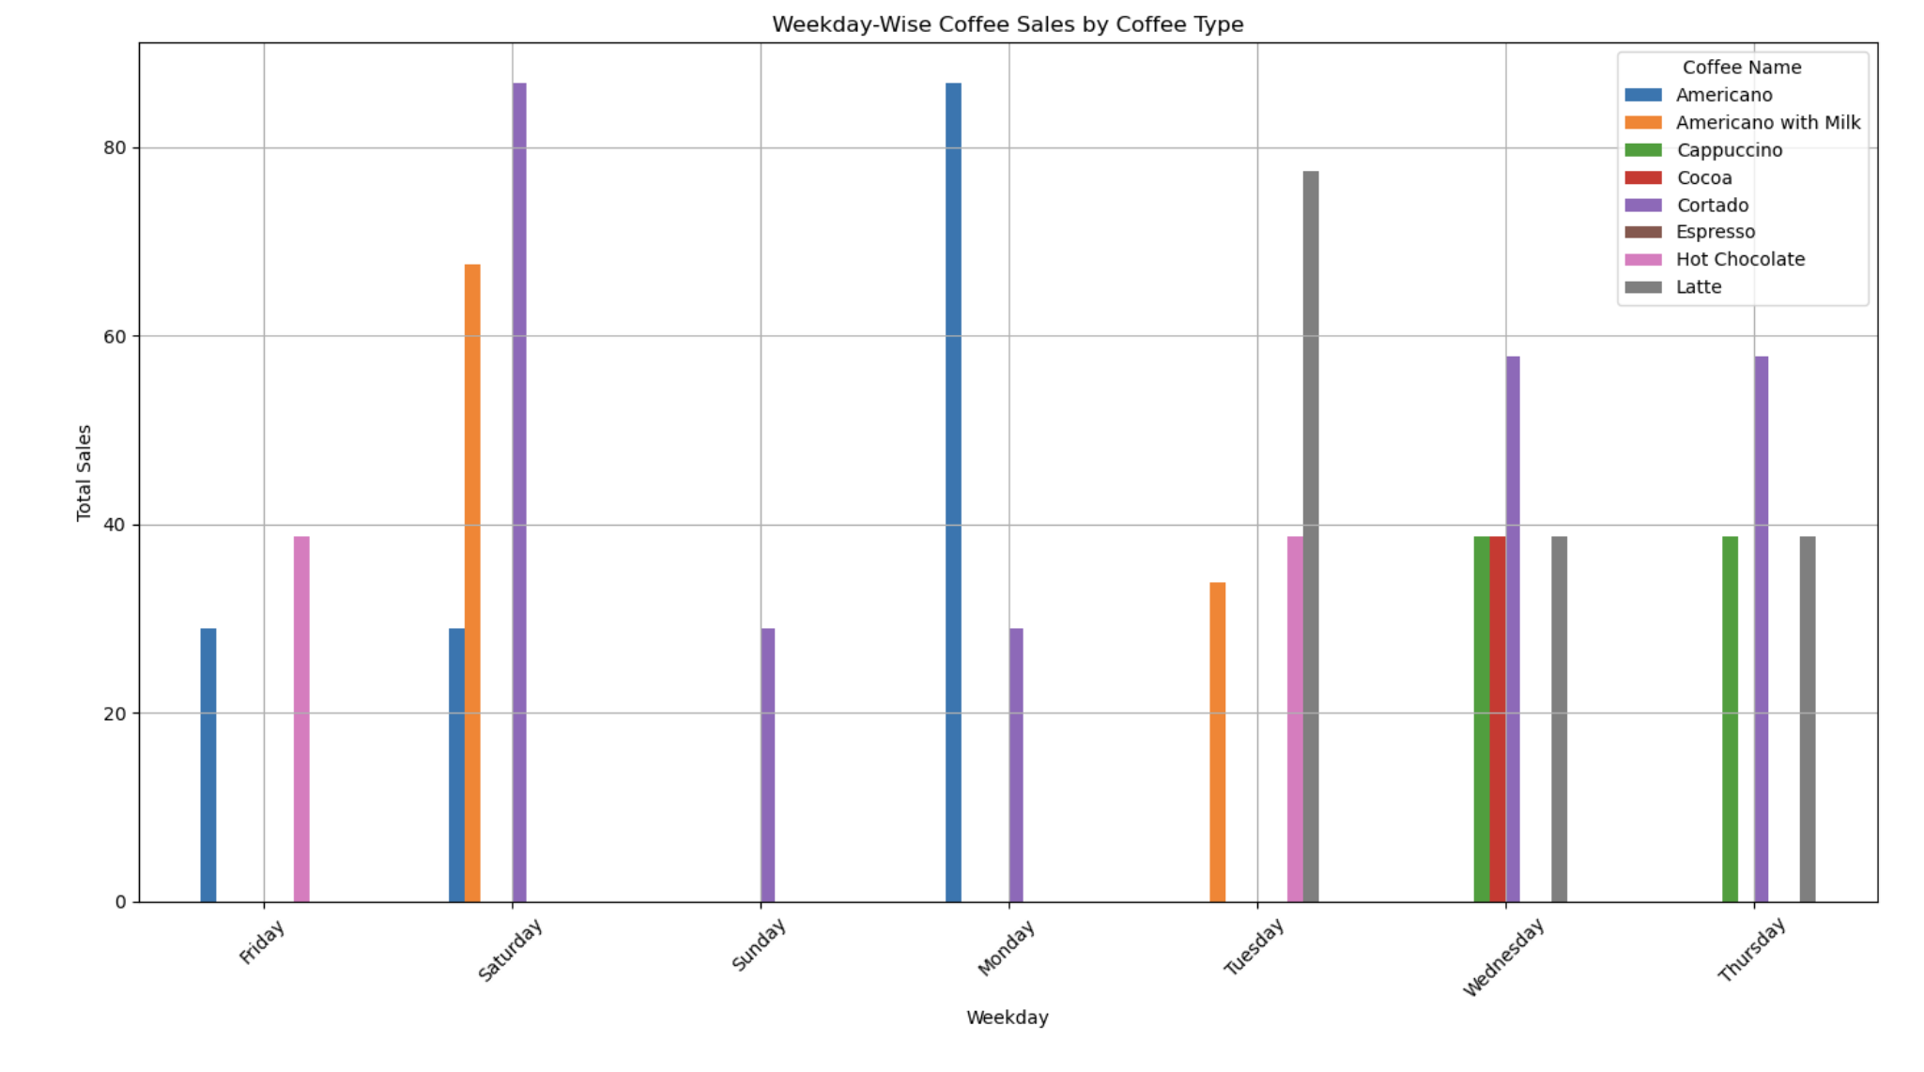
Bar Graph :
Bar graph of Weekday-wise Sales by Coffee type
EXPLANATION
>> After plotting the graph for a sample period of 15th March to 21st March 2024, we observed that the day-wise preferences varies as the highest number of sales contribution is made by Americano on Monday while it is by Cotrado on Saturday. And on Tuesday is Latte.
The graph gives an idea of the days on which the sales are more for a particular type of coffee. The reasons for variation can be understood better by analysing other parameters.

Slide 19
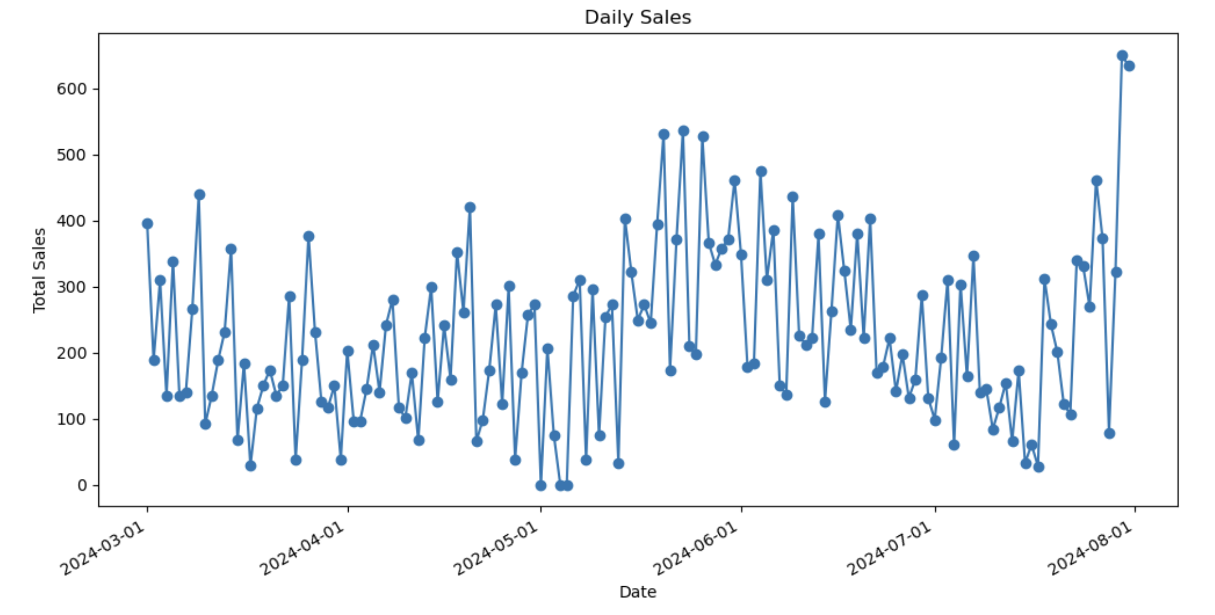
Line Graphs:
Line graph of Sales Vs Dates​
EXPLANATION
>> On observing the line plot chart, we see that it is non-linear and there is lot of variation in daily sales over the various dates. While the maximum sales on a day has been 650 (approx.), the minimum sales has been almost zero.

Slide 20
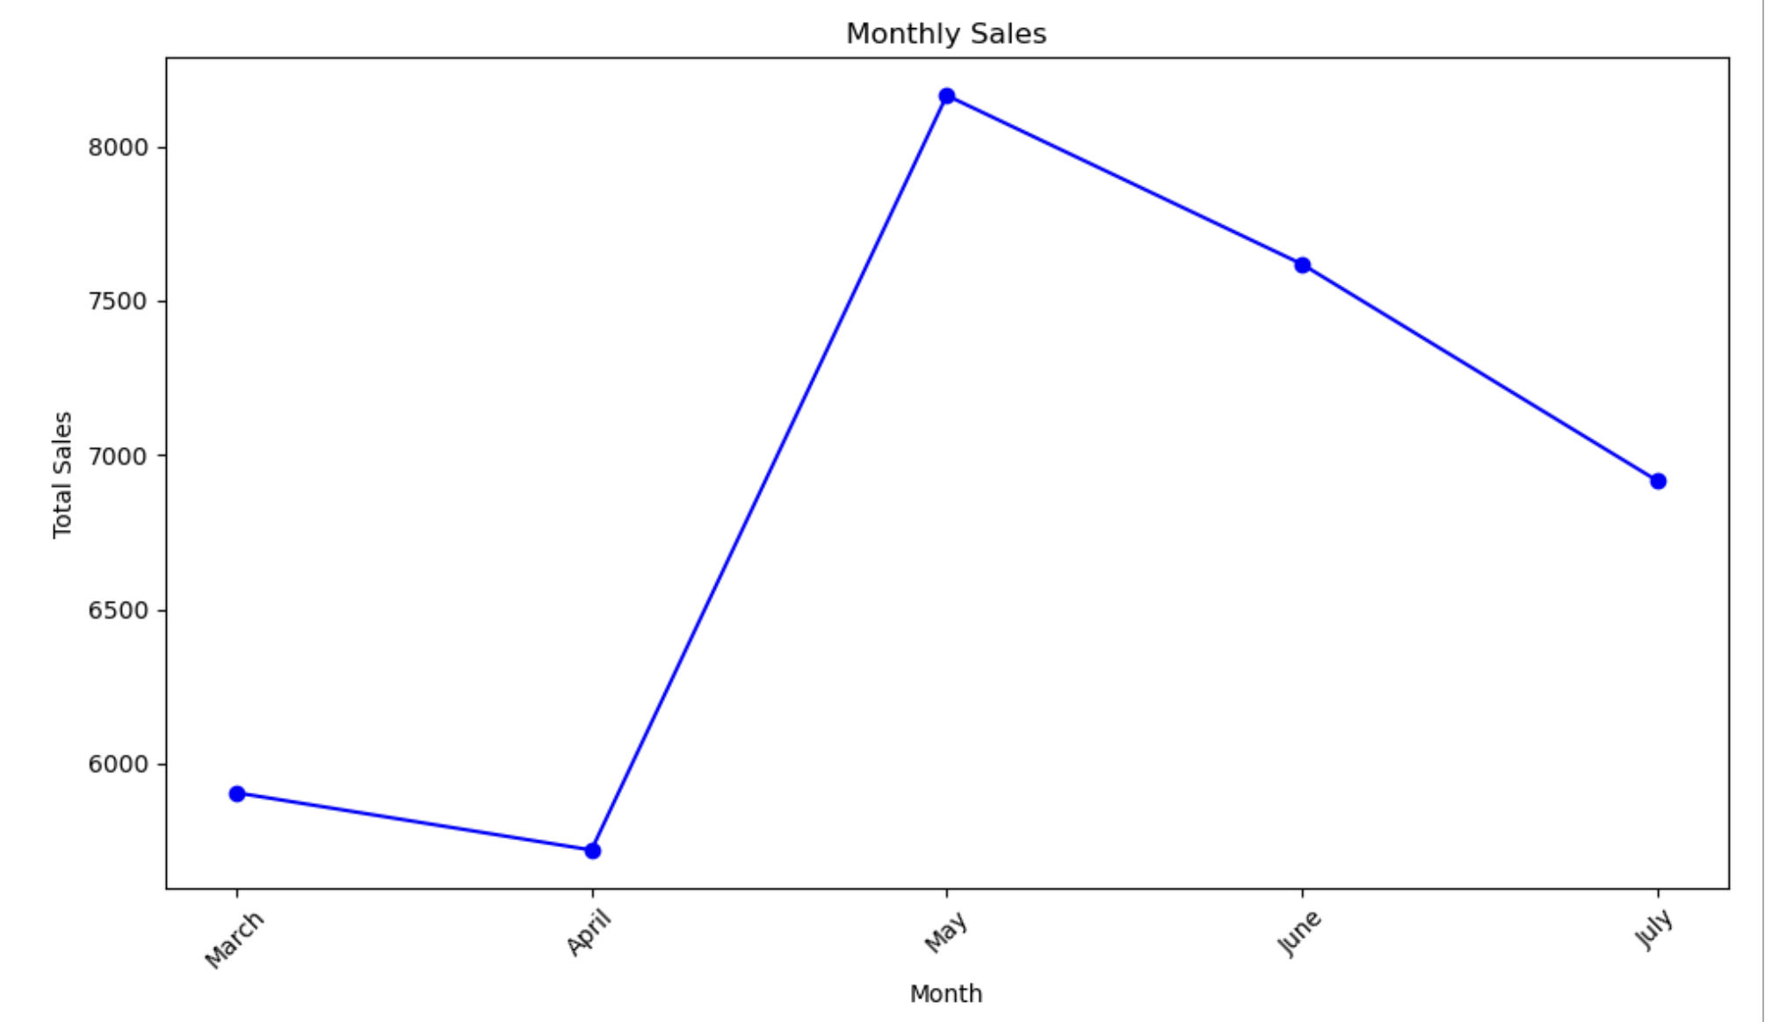
Line Graphs:
Line graph of Sales Vs Month
EXPLANATION
>> On observing the line plot chart, we see that it is non-linear and there is lot of variation in monthly sales during various months. While the maximum sales has been in the month of May 24, the minimum sales has been in April 24

Slide 21
Section 3

Slide 22
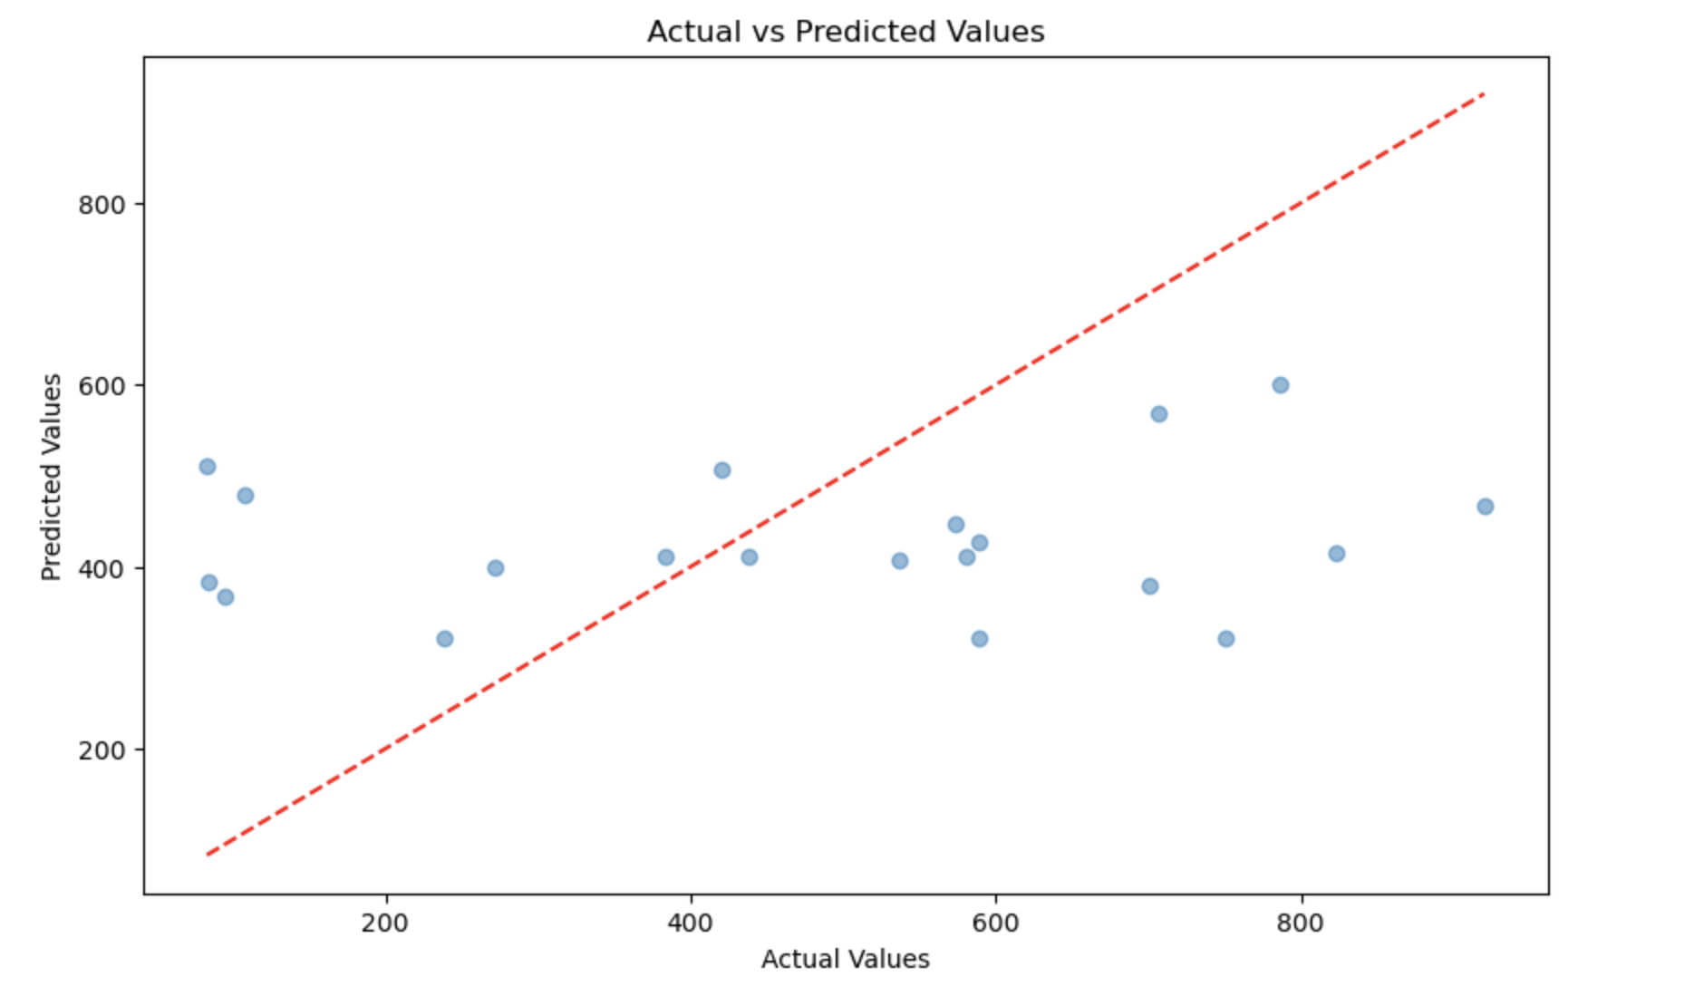
Scatter Graphs:
Scatter graph of Actuals Vs Predicted values​ for Next Day/Week/Month Sales
EXPLANATION
>> On observing the graph, drawn after applying the linear regression model in respect of the sales prediction for next day/week/month, we see that the points in the graph do not follow any specific pattern giving ground to a thought that the model is not a good fit.

Slide 23
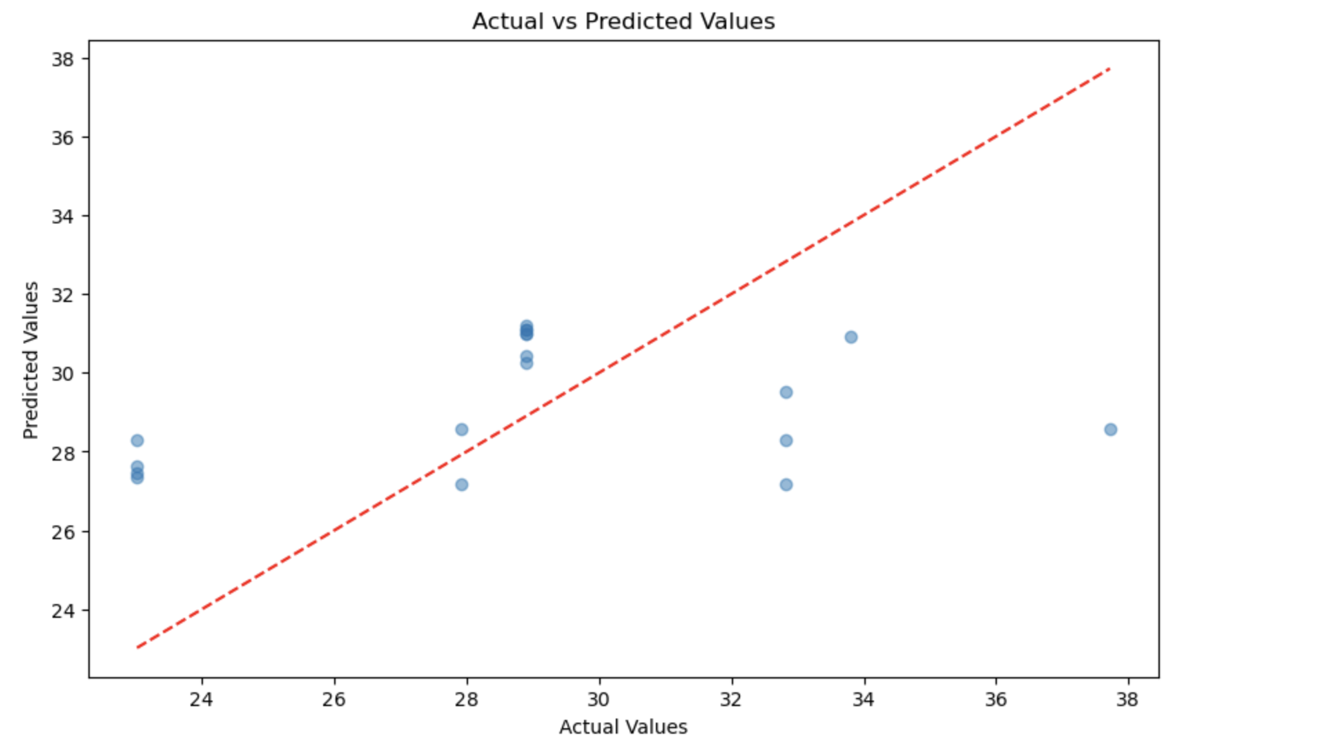
Scatter Graphs:
Scatter graph of Actuals Vs Predicted values​ for Specific Customer Purchase
EXPLANATION
>> On observing the graph, drawn after applying the linear regression model in respect of the specific customer-wise sales prediction for any day-of-the-week/month, we see that the points in the graph do not follow any specific pattern giving ground to a thought that the model is not a good fit.

Slide 24
Conclusions
At the beginning of the project, we defined the tasks that were to be performed. The tasks are :
Task - 1
Carry out Time series Exploratory Data Analysis
Task - 2
Predict Next day/week/month sales
Task - 3
Predict Specific customer purchases

Slide 25
Conclusions contd/-
Task - 1 : Carry out Time series Exploratory Data Analysis
After filtering the data for a date range, the plot for time series EDA was generated which gave the following inferences :
i. Line graph Sales Vs Date : >> On observing the line plot chart, we see that it is non-linear and there is lot of variation in daily sales over the various dates. While the maximum sales on a day has been 650 (approx.), the minimum sales has been almost zero.
ii. Line graph Sales Vs Month : >> On observing the line plot chart, we see that it is non-linear and there is lot of variation in monthly sales during various months. While the maximum sales has been in the month of May 24, the minimum sales has been in April 24
Task - 2 : Predict Next day/week/month sales
Linear regression model was used to predict the Next day/week/month sales. While testing the model following scores were obtained.
Mean Squared Error: 69407.99889353088 : Root Mean Squared Error: 263.4539787012731

Slide 26
Conclusions contd/-
Task - 2
To validate the MSE, RMSE cross validation was done and the Cross-Validated Mean Squared Error: 88468.19880590809 was obtained.
Graph of Residuals Vs Predicted Values and Actuals Vs Predicted Values were drawn.
The conclusion was that :
Model Performance: The RMSE and MSE values are quite high. This suggests that the model might not be providing accurate predictions. Whether these errors are large depends on the scale of your target variable.
Overfitting: The higher cross-validated MSE compared to the test set MSE suggests potential overfitting. The model performs better on the training set but struggles with unseen data.
Therefore, there is a felt need for feature engineering or adding additional features for evaluation and use of advanced models.

Slide 27
Conclusions contd/-
Task - 3 : Predict Specific Customer Purchases
Linear regression model was used to predict Specific Customer Purchases. While testing the model following scores were obtained.
Mean Absolute Error. : 3.2979651618634684 : Mean Squared Error. : 15.105314203785857 R² Score : 0.05631106598588986
To validate the MSE cross validation was done and the Cross-Validated MSE: 20.118520441120474 was obtained.
Graph of Residuals Vs Predicted Values and Actuals Vs Predicted Values were drawn.
The conclusion was that :
Model Performance: The MSE values is high. This suggests that the model might not be providing accurate predictions. Whether these errors are large depends on the scale of target variable.
Overfitting: The higher cross-validated MSE compared to the test set MSE suggests potential overfitting. The model performs better on the training set but struggles with unseen data.
Therefore, there is a felt need for feature engineering or adding additional features for evaluation and use of advanced models.

Slide 28
THANK YOU

Slide 29

EMPLOYEE ATTRITION ANALYSIS
George Mathew
20th September 2024

Slide 30
Outline
Executive Summary
Introduction
Methodology
Results
Conclusion

Slide 31
Executive Summary
Summary of methodologies
Data Collection through csv file downloaded using link for Exploratory Data Analysis and determining factors affecting attrition.
Data Wrangling after importing data into Power BI and using Power query for sampling data, dealing with Nulls and converting of certain data types.
Creating measures using DAX to calculate attrition-rate in case of different categories in the various parameters.
Exploratory Data Analysis by creation of visualization dashboards categorized into four major heads viz. classification as per gender, job role etc. and based on non-controllable / controllable parameters.
Summary of all results
Exploratory Data Analysis result.
Analysis of factors affecting attrition and make recommendations / suggestions.

Slide 32
Introduction
Project background and context
XYZ company which was established a few years back is facing around a 15% attrition rate for a couple of years. And it is majorly affecting the company in many aspects. In order to understand why employees are leaving the company and reduce the attrition rate XYZ company has approached an HR analytics consultancy for analyzing the data they have.
Task
Being in the HR analyst role in this project build a dashboard which can help the organization in taking data-driven decisions.

Slide 33
Section 1

Slide 34
Methodology
Executive Summary
Data collection methodology:
Data was collected using the download link provided.
Perform data wrangling
Wrangling done using Sampling data and dealing with Nulls, converting data types and creating of measures using DAX.
Perform exploratory data analysis (EDA) using dashboards visualisations.
Perform analysis of factors affecting attrition and make recommendations / suggestions
By preparing dashboards, categorising the visualisations under four major heads viz. classification as per gender, job role etc. and based on non-controllable / controllable parameters, recommendations / suggestions are made to help the organization in taking data-driven decisions.

Slide 35
Data Collection and its Presentation
Data was collected using the download link provided.
Inspecting Data: Check the types and initial content.
Wrangling done using Sampling data and dealing with Nulls.
Data Type Conversion: Convert fields to the appropriate types.
Aggregating Data: Create measures using DAX for calculating attrition-rate.

Slide 36
EDA with Data Visualization – Classification on Major Parameters
Bar Graphs: ​
Attrition by Gender
>> After plotting the graph, we observed that number-wise the attrition is higher in males (430) than in females (265).
To understand whether the attrition-rate gender-wise also follows the same trend, we calculated the attrition-rate gender-wise and found that the attrition-rate is higher in males (17%) than in females (15%)
Attrition by Department
>> After plotting the graph, we observed that number-wise the attrition is highest in Research & Dev. deptt. (443) followed by Sales deptt. (198) and then by HR (54).
To understand whether the attrition-rate department-wise also follows the same trend, we calculated the attrition-rate department-wise and found that the attrition-rate is highest in HR (29%) followed by Research & Dev deptt. (16%) and then by Sales deptt. (15%). The higher percentage in HR needs further analysis as it is observed that in HR the number of attrition under Job Role ‘Sales Executive’ is 23 of the total of 54 attritions. Either there is error in department.-wise, classification as we also find HR Job-Role in other departments as well or the Job Role needs to be focussed upon to understand the reasons.

Slide 37
EDA with Data Visualization – Classification on Major Parameters- contd/-
Bar Graphs: ​
Attrition by Job-Role
>> After plotting the graph, we observed that number-wise the attrition is highest in the ‘Sales Executive’ Job-Role (162) followed by Research Scientist (158) then by Laboratory Technician (122), Healthcare Representative (55), Research Director (54), Manufacturing Director (48), Manager (39), Sales Representative (36) and Human Resources (21) in descending order..
To understand whether the attrition-rate job-role-wise also follows the same trend, we calculated the attrition-rate job-role-wise and found that the attrition-rate is highest in the ‘Research Director’ Job-Role (23%) followed by Research Scientist (18%) then by Sales Executive (17%), Laboratory Technician (16%), Healthcare Representative (15%), Sales Representative (15%), Human Resources (14%), Manager (13%) and Manufacturing Director (11%) in descending order. When it comes to percentage-wise attrition the change in order is noticeable as far as the ‘Research Director’ Job-Role is concerned and it needs to be focussed upon.
Attrition by Monthly-Income-Range
>> After plotting the graph, we observed that number-wise the attrition is highest in the income range ‘25000 to 39999’ (158) followed by ‘40000 to 54999’ (148) then by ‘55000 to 69999’ (108), ‘10000 to 24999’ (103), ’145000 and more’ (58), ‘70000 to 84999’ (38), ‘100000 to 114999’ (34), ‘85000 to 99999’ (27), ‘130000 to 144999’ (18) and ‘115000 to 129999’ (3).
To understand whether the attrition-rate income-range-wise also follows the same trend, we calculated the attrition rate income-range-wise and found that the attrition-rate is highest in the income range ‘25000 to 39999’ (79%) followed by ‘40000 to 54999’ (74%) then by ‘55000 to 69999’ (54%), ‘10000 to 24999’ (52%), ’145000 and more’ (29%), ‘70000 to 84999’ (19%), ‘100000 to 114999’ (17%), ‘85000 to 99999’ (14%), ‘130000 to 144999’ (9%) and ‘115000 to 129999’ (2%).

Slide 38
EDA with Data Visualization – Non-controllable Parameters
Line Graphs: ​
Attrition by Distance From Home
>> After plotting the graph, we observed that graph is non-linear with non-linear variations. While the number of attrition of 113 is the highest where the distance from home is 2 (assuming the unit to be km), the next highest being 93 where the distance from home is 1 km. The next highest is a distant 60 where the distance from home is 10 km. So, overall, it is observed that the attrition is highest where the distance from home is at a lower range upto 2 kms. However, as the HR cannot have any say in the matter, so it has been categorised under non-controllable parameter.
Attrition by Percentage Salary Hike
>> After plotting the graph, we observed that graph is non-linear but is sloping downwards. While the number of attrition of 98 is the highest, where the percentage salary hike is 13%, the next highest is 90 where the percentage salary hike is 11% followed by the next highest being 86 where the percentage salary hike is 12% & 14%. The next is a distant 62 where the percentage salary hike is 15% and the lowest is 9 where the percentage salary hike is 24%. So, overall, it is observed that the attrition is higher where the salary hike ranges from 11% to 14%, while it decreases as the percentage salary hike reaches 15% and over. However, as the HR cannot have any say in the matter, so it has been categorised under non-controllable parameter.

Slide 39
EDA with Data Visualization – Non-controllable Parameters
Line Graphs:
Attrition by Years at Company
>> After plotting the graph, we observed that graph is non-linear with non-linear variations. While the number of attrition of 175 is the highest where the years at company is 1, the next highest being 79 where the years at company is 2. The next highest is 61 where the years at company is 5. While an unusual peak of 53 is where the years at company is 10, all others are below 50 and beyond 10 years at company the number of attrition is low at 6, 4, 3 in that range. So, overall, it is observed that the attrition is highest where the years at company is at a lower range upto 10 years. However, as the HR cannot have much say in the matter looking to the trend of employees with lesser years of service switching jobs after gaining little experience seeking higher salaries, so it has been categorised under non-controllable parameter.
Attrition by Total Working Years
>> After plotting the graph, we observed that graph is non-linear with non-linear variations. While the number of attrition of 118 is the highest where the total working years is 1, the next highest being 74 where the total working years years is 10. The next highest is 64 where the total working years is 6. While the number of attrition is 21 and above in other cases of total working years upto 11, the number of attrition in case of total working years above 11 years is below 21. So, overall, it is observed that the attrition is highest where the total working years is at a lower range upto 10 years. However, as the HR cannot have much say in the matter looking to the trend of employees with lesser years of service switching jobs after gaining little experience seeking higher salaries, so it has been categorised under non-controllable parameter.

Slide 40
EDA with Data Visualization – Controllable Parameters - Action HR
Bar Graphs: ​
Attrition by Business Travel
>> After plotting the graph, we observed that number-wise the attrition is highest in the travel-rarely category (460) followed by travel frequently (199) and lastly non-travel (36).
To understand whether the attrition rate travel category-wise also follows the same pattern, we calculated the attrition rate travel category-wise and found that the attrition-rate is highest in the travel frequently category (25%) followed by travel-rarely (15%) and lastly non-travel(8%). When it comes to attrition-rate the change in order is noticeable as far as the travel frequently category is concerned which needs to be focussed upon.
Attrition by Marital Status
>> After plotting the graph, we observed that number-wise the attrition is highest in the single category (350) followed by married (251) and lastly divorced (94).
To understand whether the attrition rate marital status-wise also follows the same pattern, we calculated the attrition rate marital status-wise and found that the attrition-rate is highest in the single category (25%) followed by married (13%) and lastly divorced (10%).

Slide 41
EDA with Data Visualization – Controllable Parameters - Action HR – contd/-
Bar Graphs: ​
Attrition by Work Life Balance
>> After plotting the graph, we observed that number-wise the attrition is higher in work life balance category ‘3’ (375) then in category ‘2’ (167), then in category ‘4’ (80) and lastly in category ‘1’ (73).
To understand whether the attrition-rate work life balance category-wise also follows the same trend, we calculated the attrition rate work life balance category-wise and found that the attrition-rate is highest in work life balance category ‘1’ (31%) then in category ‘4’ (18%), then in category ‘2’ (17%) and lastly in category ‘3’ (14%). Thus, we see that attrition-rate-wise work life balance category ‘3’ has the lowest rate while number of attrition-wise it has the highest figures. We find that the attrition-rate in all the category except category ‘1’ is around the average attrition-rate. The category ‘1’ needs to be looked in to. We find that Job-Role-wise ’Research Scientist’ is the highest number (17) under work life balance category ‘1’. Similar other factors like years at company, marital status also have a correlation.
Attrition by Training Times Last Year
>> After plotting the graph, we observed that number-wise the attrition is higher in training times last year category ‘2’ (273) then in category ‘3’ (253) then in category ‘5’ (51) then in category ‘4’ (47) then in category ‘0’ (30) then in category ‘1’ (29) and lastly in category ‘6’ (12).
To understand whether the attrition-rate training times last year category-wise also follows the same trend, we calculated the attrition-rate training times last year category-wise and found that the attrition is highest in training times last year category ‘0’ (19%) then in category ‘3’ (18%) then in category ‘2’ (17%) then in category ‘5’ (15%) then in category ‘1’ (14%) then in category ‘4’ (13%) and lastly in category ‘6’ (6%). Although the highest training times last year category ‘6’ has the least attrition-rate yet in other categories the variation in attrition-rate is not very significant.

Slide 42
EDA with Data Visualization – Controllable Parameters – Action HR & Employee
Bar Graphs: ​
Attrition by Job Satisfaction
>> After plotting the graph, we observed that number-wise the attrition is higher in job satisfaction category ‘3’ (214) then in category ‘1’ (194), then in category ‘4’ (152) and lastly in category ‘2’ (135).
To understand whether the attrition-rate job satisfaction category-wise also follows the same trend, we calculated the attrition-rate job satisfaction category-wise and found that the attrition-rate is highest in job satisfaction category ‘1’ (23%) then in category ‘3’ (17%), then in category ‘2’ (16%) and lastly in category ‘4’ (11%). Thus, we see that attrition-rate-wise job satisfaction category ‘4’ has the lowest rate. The number of attrition in job satisfaction category ‘1’ (194) and the attrition rate thereof (23%) points towards the fact that frequent job satisfaction survey and employee engagement can help reduce the attrition under this sub-category.
Attrition by Stock Option Level
>> After plotting the graph, we observed that number-wise the attrition is higher in stock option level category ‘0’ (311) then in category ‘1’ (263), then in category ‘2’ (84) and lastly in category ‘3’ (37).
To understand whether the attrition-rate stock option level category-wise also follows the same trend, we calculated the attrition-rate stock option level category-wise and found that the attrition-rate is highest in stock option level category ‘2’ (18%) then in category ‘0’ (17%), then in category ‘1’ & ‘3’ (15%). Thus, we see that attrition-rate-wise job satisfaction category ‘1’ & ‘3’ have the lowest rate.
The attrition-rate being near the average for almost all the categories, it appears that other factors have a overarching effect compared to the stock option level.

Slide 43
EDA with Data Visualization – Controllable Parameters – Action HR & Employee
Bar Graphs: ​
Attrition by Performance Rating
>> After plotting the graph, we observed that number-wise the attrition is higher in performance rating category ‘3’ (573) and lowest in category ‘4’ (122).
To understand whether the attrition-rate job satisfaction category-wise also follows the same trend, we calculated the attrition-rate performance rating category-wise and found that the attrition-rate is highest in performance rating category ‘4’ (18%) and lowest in category ‘3’ (16%).
The attrition-rate being near the average for both the categories, it appears that other factors have a overarching effect compared to the performance rating.
Attrition by Job Involvement
>> After plotting the graph, we observed that number-wise the attrition is higher in job involvement category ‘3’ (388) then in category ‘2’ (178), then in category ‘4’ (77) and lastly in category ‘1’ (52).
To understand whether the attrition-rate job satisfaction category-wise also follows the same trend, we calculated the attrition-rate job involvement category-wise and found that the attrition-rate is highest in job involvement category ‘1’ (22%) then in category ‘4’ (18%), then in category ‘2’ (16%) and lastly in category ‘3’ (15%). Thus, we see that attrition-rate-wise job involvement category ‘1’ has the highest rate. Although number-wise, the attrition in job involvement category ‘1’ (52) yet the attrition rate thereof (22%) points towards the fact that frequent job involvement survey and taking care of other parameters in addition to employee engagement can help reduce the attrition under this sub-category.

Slide 44
Section 2

Slide 45
Results
Exploratory data analysis results

Slide 46
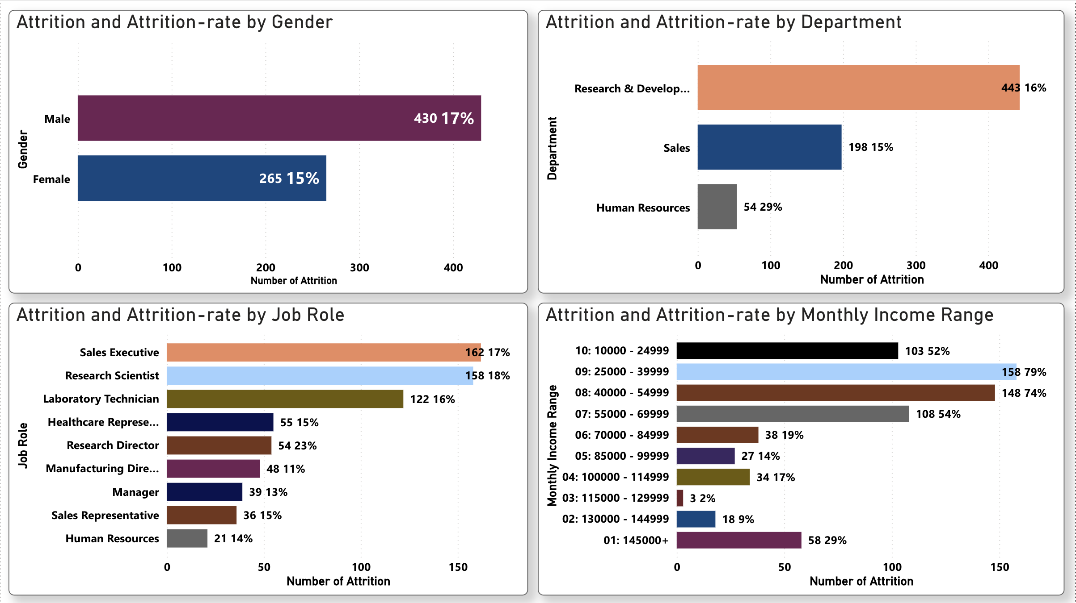
Attrition by Gender_Department_Job Role_Mnthly Income

Slide 47
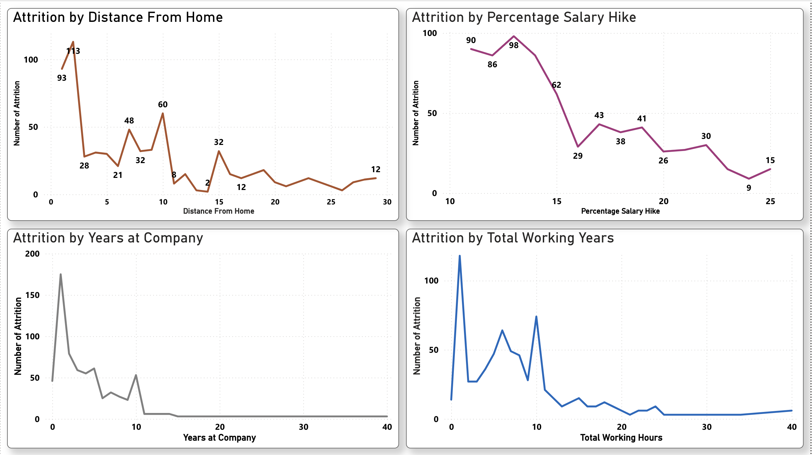
Attrition_Non_controllable_Parameters

Slide 48
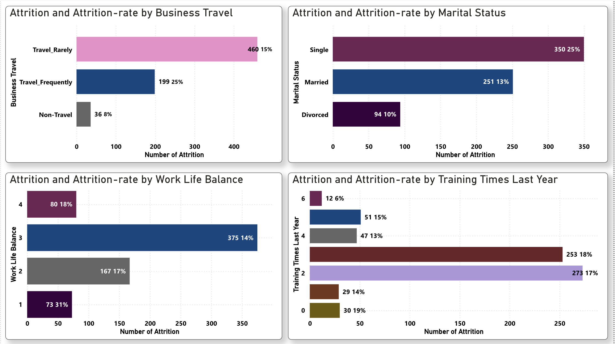
Attrition_Controllable_Parameters_Action HR

Slide 49
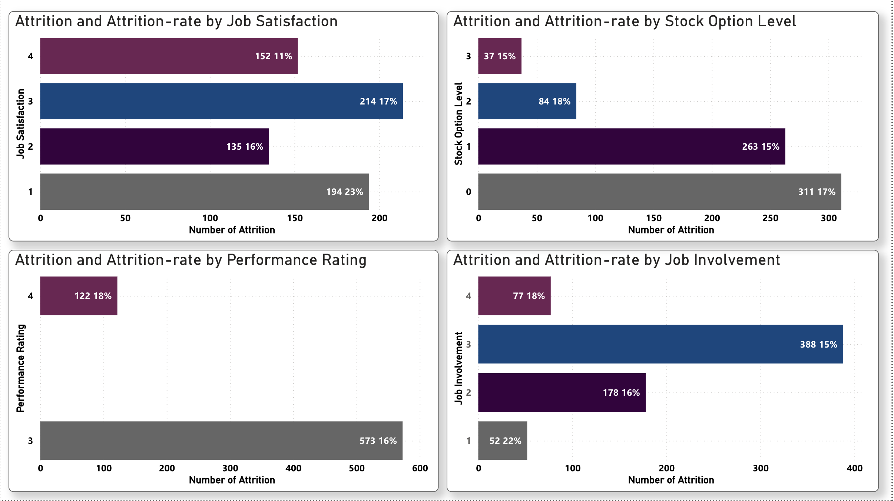
Attrition_Controllable_Parameters_Action_HR_&_Employee

Slide 50
Section 3

Slide 51
Conclusions
At the beginning of the project, we defined the tasks that were to be performed.
Task
Being in the HR analyst role in this project build a dashboard which can help the organization in taking data-driven decisions.
Dash boards categorisation was done into four major areas viz :
i. Classification of attrition on Majorly independent Parameters
ii. Classification of attrition on Non-controllable Parameters
iii. Classification of attrition on Controllable Parameters where Action by HR is suggested
iv. Classification of attrition on Controllable Parameters where Action by HR & Employee is suggested

Slide 52
Conclusions contd/-
Analysis of the visualisations created in the dashboard was done. Based on the observations of the attrition and attrition-rates under different categories of the various parameters the areas of concerns are listed below and the suggestions that would help reduce the attrition rate are also appended.
Identifying risk factors for employee attrition
There are signs that are revealed from the observations of the Visualisations to help the HR team identify where the company is at risk of high attrition that can potentially be detrimental to the business:
The attrition by gender-wise bar graph although gives a pattern yet if the gender and marital status are taken together and analysed then based on the understanding it will be useful to take suitable steps to reduce attrition.
The higher percentage in HR department needs further analysis as it is observed that in HR the number of attrition under Job Role ‘Sales Executive’ is 23 of the total of 54 attritions. Either there is error in department.-wise, classification or the Job Role needs to be focussed upon to understand the reasons. The attrition-rate in HR deptt (29%) appears skewed due to the contribution by ‘Sales Executive’ Job Role while the overall attrition-rate of ‘Sales Executive’ Job Role is 17 %.
High attrition in departments can be taxing for managers. They might have to find additional staff to cover shifts during vacancies or perform lower-level worker tasks to cope with understaffing. Critical incidents may also occur resulting from team members’ mistakes that tie up the manager’s time in remedying these situations.
When it comes to attrition-rate by Job-Role, the number of attrition by Job-Role is noticeable as far as the ‘Research Director’ Job-Role is concerned and it needs to be focussed upon as the attrition-rate is 23% which is quite higher than the average attrition-rate.

Slide 53
Conclusions contd/-
Suggestions based on the observations :
When it comes to attrition-rate by Business travel, the number of attrition is noticeable as far as the ‘travel frequently’ category is concerned, and it needs to be focussed upon as the attrition-rate is 25% which is quite higher than the average attrition-rate. Either employees who travel frequently need to be incentivised with some discomfort allowance or the travelling job need to be realigned so that the frequency of travel is not a irritant to the employee leading to attrition.
It is observed that the attrition-rate marital status-wise is highest in the single category (25%) as against the overall average of 16%. Although having young staff in the rolls is beneficial as far as containing the staff expenses is concerned but if the understanding gained from the analysis of attrition-rate marital status-wise is applied at the time of recruitment the company can prefer married candidates if other eligibility criteria and performance in test and interview are equal, to reduce the attrition-rate.
The number of attrition in job satisfaction category ‘1’ (194) and the attrition-rate thereof (23%) points towards the fact that frequent job satisfaction survey and employee engagement can help reduce the attrition under this sub-category.
It is observed that the attrition-rate-wise job involvement category ‘1’ has the highest rate. Although number-wise, the attrition in job involvement category ‘1’ (52) is comparatively not large yet the attrition rate thereof (22%) points towards the fact that frequent job involvement survey and taking care of other parameters in addition to employee engagement can help reduce the attrition under this sub-category as declining employee engagement or lower job involvement plays a huge role in employee attrition. When employees lose interest in their jobs, they become disconnected from their peers and managers ; and are less productive too.

Slide 54
THANK YOU

Slide 55

CROP PRODUCTION ANALYSIS IN INDIA
George Mathew
5th October 2024

Slide 56
Outline
Executive Summary
Introduction
Methodology
Results
Conclusion

Slide 57
Executive Summary
Summary of methodologies
Data Collection through csv file downloaded using link for Exploratory Data Analysis and determining factors affecting crop production and also predicting crop production.
Data Wrangling after importing data into SQLite and using SQL for sampling data, dealing with Nulls, ‘0’ and blank values and converting of certain data types.
Exploratory Data Analysis by creation of visualization dashboards and story in Tableau.
Summary of all results
Exploratory Data Analysis result.
Analysis of factors affecting crop production and also predicting crop production.

Slide 58
Introduction
Project background and context
Problem Statement
The Agriculture business domain, as a vital part of the overall supply chain, is expected to highly evolve in the upcoming years via the developments, which are taking place on the side of the Future Internet. This dataset provides a huge amount of information on crop production in India ranging from several years.
Task
Based on the Information the ultimate goal would be to predict crop production and find important insights highlighting key indicators and metrics that influence crop production.
Make views and dashboards first and also make a story out of it.
Share the Tableau PublicLink of the work

Slide 59
Section 1

Slide 60
Methodology
Executive Summary
Data collection methodology:
Data was collected using the download link provided.
Perform data wrangling
Wrangling done using Sampling data and dealing with Nulls, ‘0’ and blank values and converting of certain data types.
Perform exploratory data analysis (EDA) using dashboards visualisations.
Perform analysis of factors affecting crop production and also predicting crop production.
By preparing charts in Tableau, dashboards and the story analysis of factors affecting crop production and also predicting crop production is done.

Slide 61
Data Collection and its Presentation
Data was collected using the download link provided.
Inspecting Data: Check the types and initial content.
Wrangling done using Sampling data and dealing with Nulls, ‘0’ and blank values.
Data Type Conversion: Convert fields to the appropriate types.

Slide 62
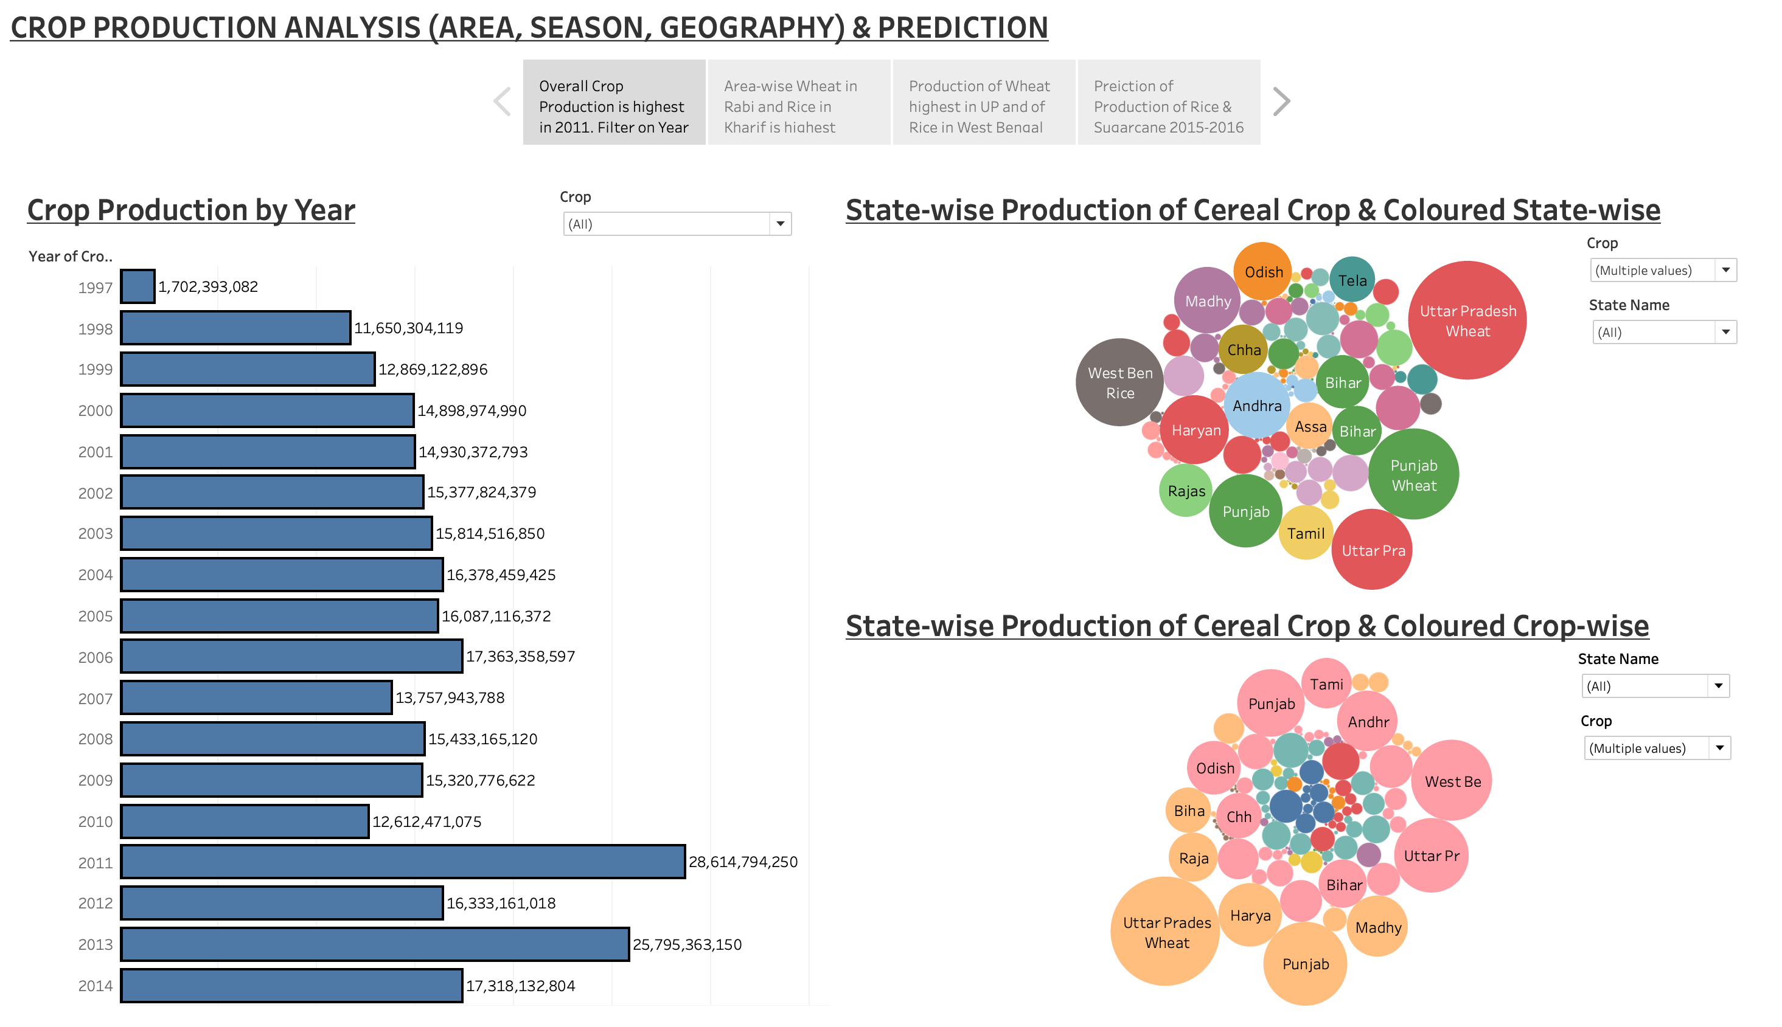
EDA with Data Visualisation
Dashboards used to make Story - 1

Slide 63
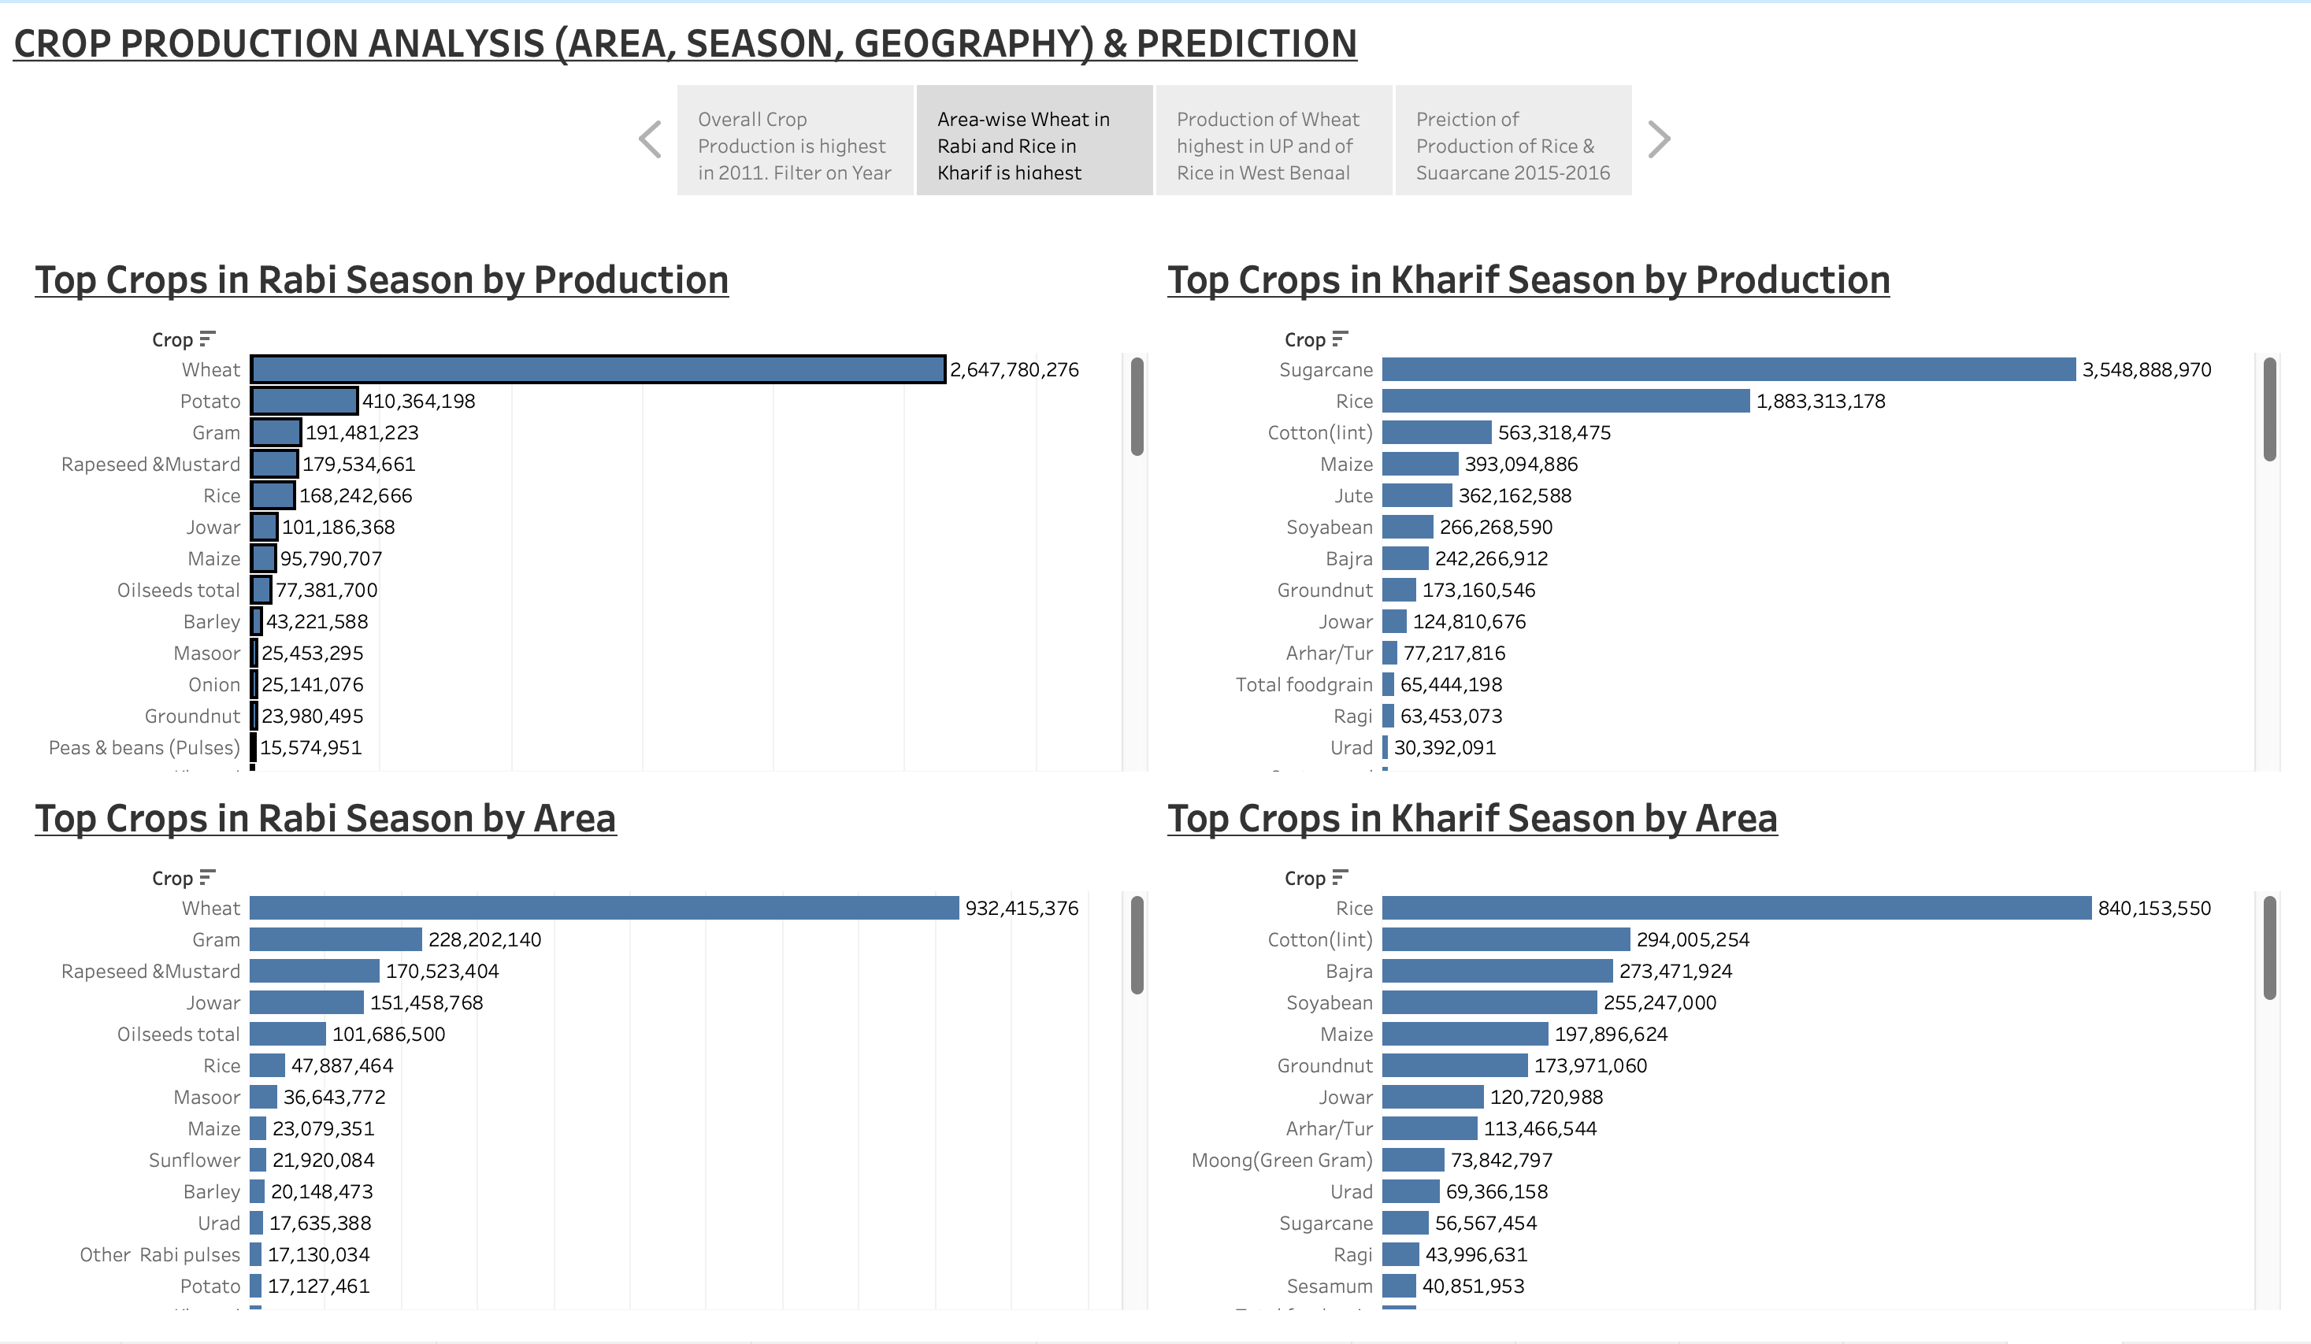
EDA with Data Visualisation
Dashboards used to make Story - 2

Slide 64
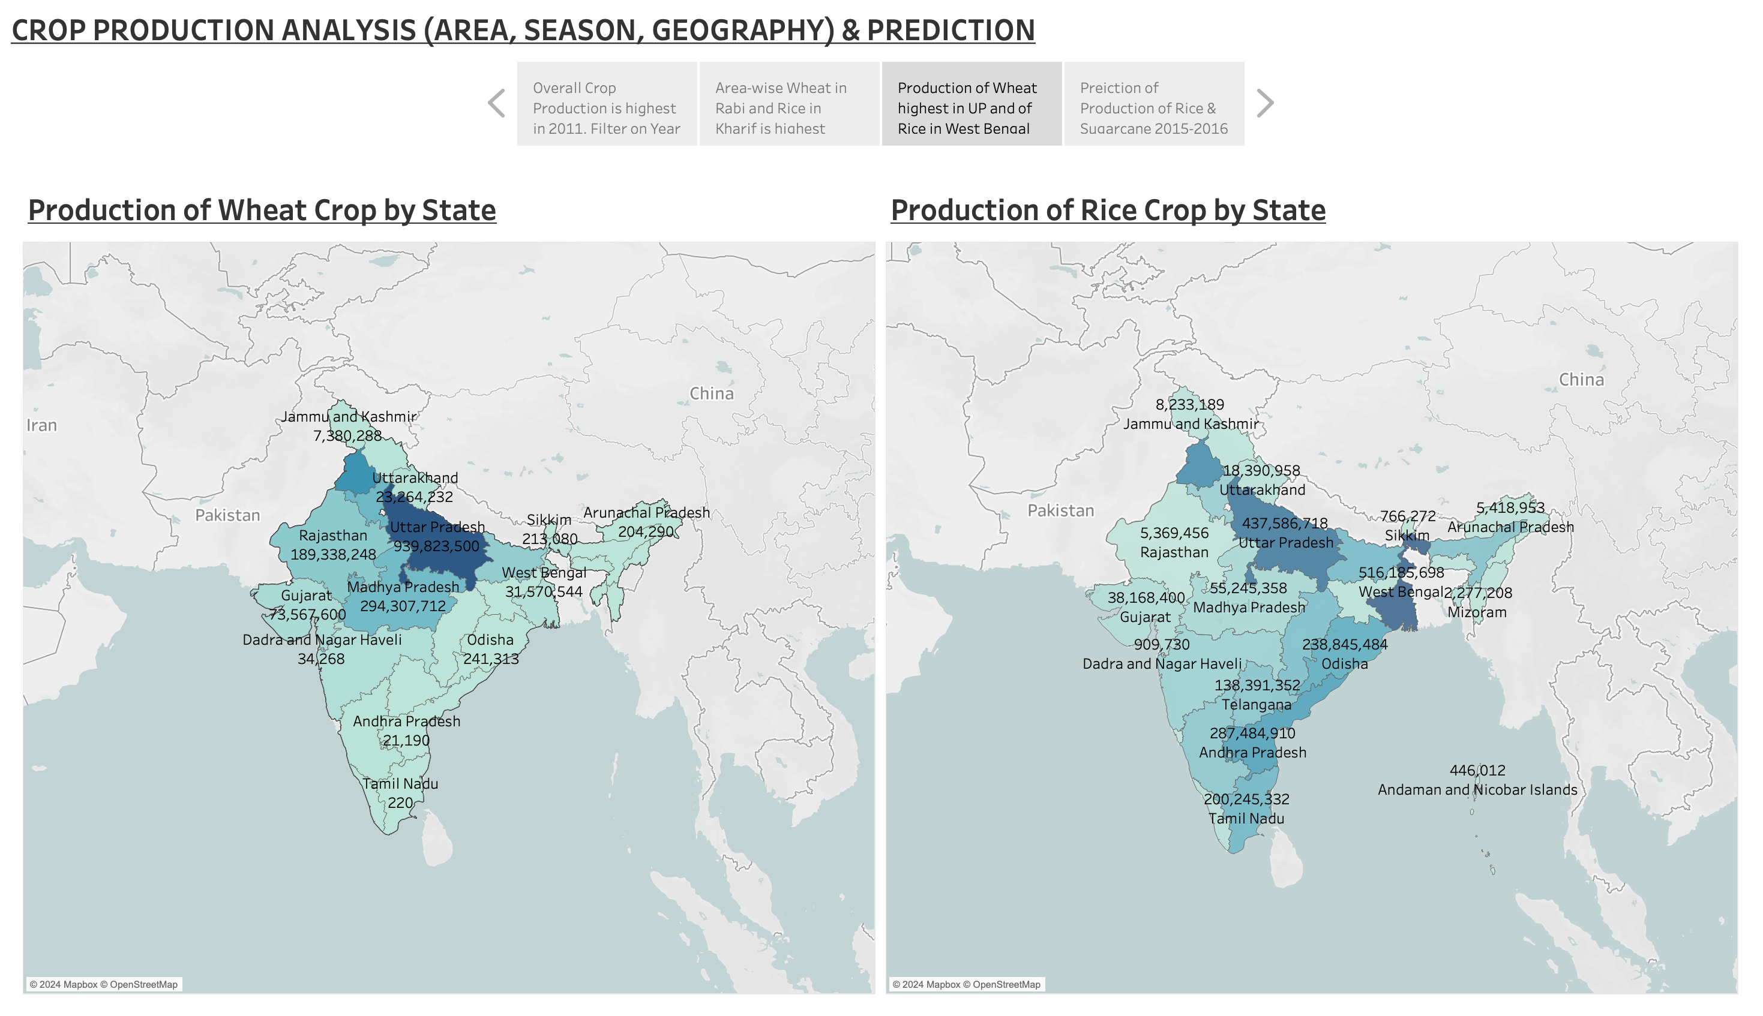
EDA with Data Visualisation
Dashboards used to make Story - 3

Slide 65
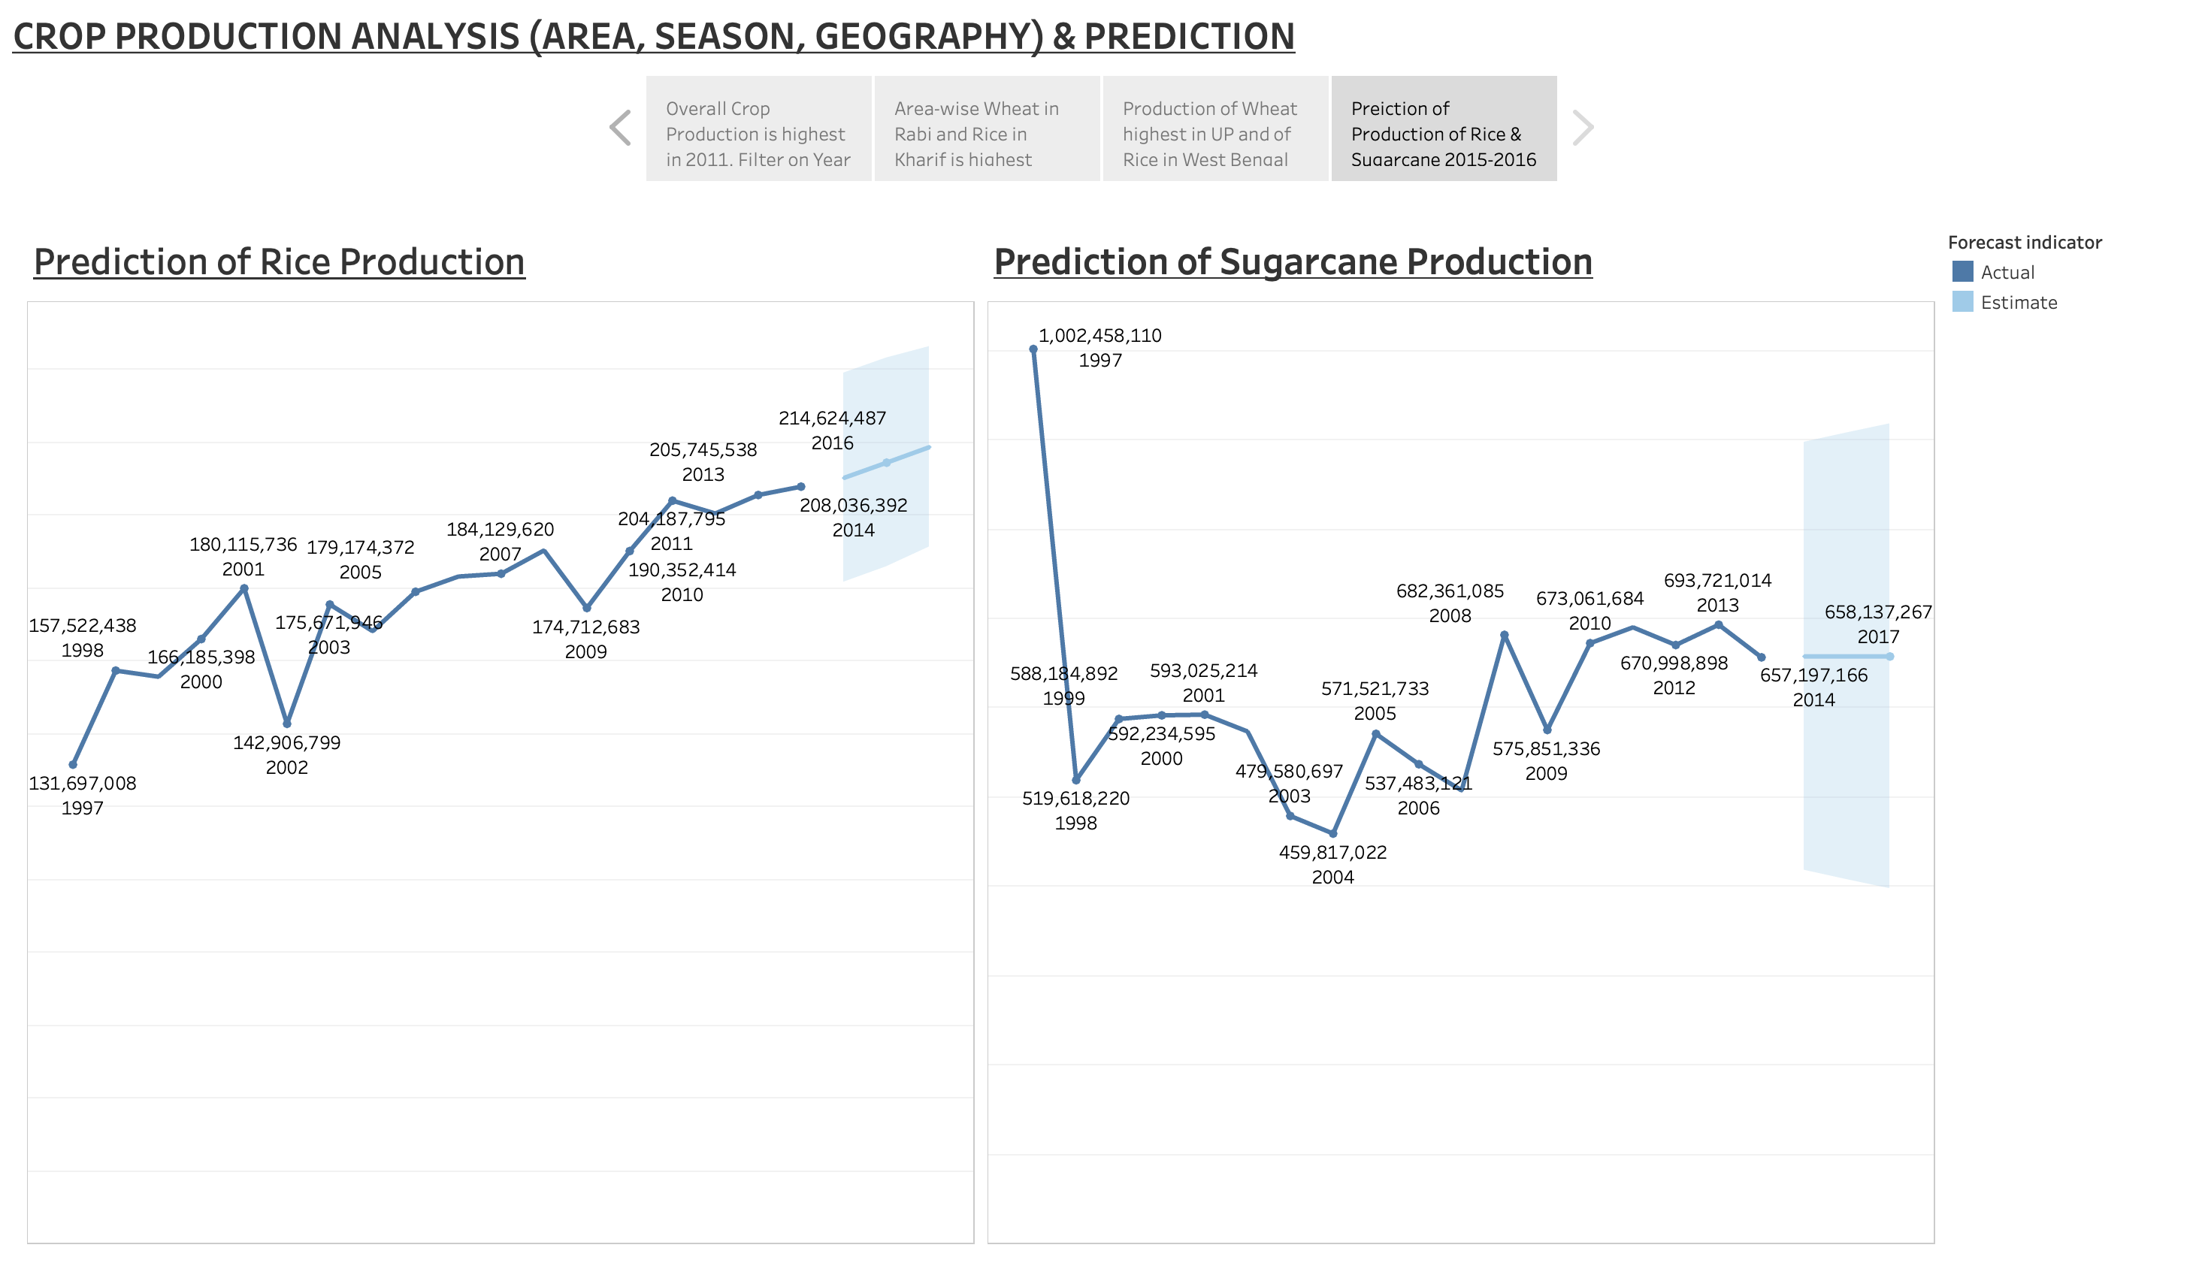
EDA with Data Visualisation
Dashboards used to make Story - 4

Slide 66
Section 2

Slide 67
Results
Exploratory data analysis results
Using Exploratory Data Analysis the factors affecting crop production like Seasons, Geography, Area of crop were analysed and also prediction of crop production based on previous pattern was also found out.
Story -1
The Bar chart showing Crop production by Year displays the Year 2011 as the year with highest Crop production during the period covering 1998 to 2014. Alongside, the Bubble chart showing the State-wise production of Cereals / Millets in Crop production displays that Uttar Pradesh has the highest production when it comes to Wheat and is followed by Rice. Similar is the case of Punjab while West Bengal is majorly Rice producing State. The other chart where color was used to identify crops helped to identify easily the State which produces the highest quantity of any particular crop. The filter option in the ‘Crop production by Year’ Bar chart when used, can give the year-wise state-wise Cereals / Millets crop production.
Story - 2
Four Bar charts depicting the Top crops in Rabi season by Production and Area as also in Kharif season by Production and Area identifies Wheat as the Top crop in Rabi season both by Production as well as Area while in case of Kharif season while Sugarcane is the Top crop by Production in case of Top crop by Area in Kharif season it is Rice.

Slide 68
Results
Exploratory data analysis results contd/-
Story -3
The chart using Maps is showing Production of Wheat crop by State and Production of Rice crop by State. The Maps depict that it is Uttar Pradesh which has the highest production of Wheat crop while it is West Bengal which has the highest production of Rice crop. The intensity of the colours filling the maps of states helps to identify the highest and the lowest production of Wheat and Rice state-wise.
Story - 4
While the line charts used to draw the year-wise production of Rice and Sugarcane shows an increasing trend the option available to forecast the trend for the future years gives the data for the years 2015, 2016 and 2017. The estimates for the years 2015, 2016 and 2017 in respect of Rice crop and in respect of Sugarcane crop is displayed in the chart.

Slide 69
Section 3

Slide 70
Conclusions
At the beginning of the project, we defined the tasks that were to be performed.
Task
Based on the Information the ultimate goal would be to predict crop production and find important insights highlighting key indicators and metrics that influence crop production.
Make views and dashboards first and also make a story out of it.
Share the Tableau PublicLink of the work

Slide 71
Conclusions
The task has been accomplished, viz we have found that the season like Rabi, Kharif etc are factors which determine the crop that is grown and the production. Similarly the area of cultivation of the crop also influences the production of the various. Another factor i.e. geography also influences the production pattern identifying Uttar Pradesh as the state having the highest production of Wheat. We also predicted the production of crops and as a sample the dashboard and story is depicting the estimated production figure for the years 2015, 2016, 2017.
The Tableau PublicLink of the work is
https://public.tableau.com/views/CropProductionAnalysisPredictionWorkbook/Story1?:language=en-GB&:sid=&:redirect=auth&:display_count=n&:origin=viz_share_link

Slide 72
Appendix
Post Inspection of Data its Analysis and Treatment of Null, ‘0’ and blank values in ‘Production’ field
Total crops as per the data : 124, File name ‘List of 124 crops with count of total rows and count of 0 null blank value in production rows and percentage to total.csv’
Total rows originally : 485886
Total crops with not null, non-zero or not blank entries in production is 26 and is having 4200 rows.
Rows with ‘0’ zero, null or blank production figures : 10940
Rows deleted where all rows of the crops have ‘0’ zero, null or blank entries in ‘Production’ field i.e. 100% OR where crop-wise count of rows having null or ‘0’ entries in ‘Production’ field is greater than 0 and less than or equal to 5% of the crop-wise total rows :

Slide 73
Appendix
Post Inspection of Data its Analysis and Treatment of Null, ‘0’ and blank values in ‘Production’ field (contd/-)
vi. For 69 crops total rows are 466808 and there are 7908 rows which have ‘0’, null, blank values in ‘Production’ field of which 663 rows were of the following 19 crops having 100% ‘0’, null or blank entries in ‘Production’ field.
(a) Apple – 4; (b) Ash Gourd – 44; (c) Beet Root – 16; (d) Ber – 11; (e) Cucumber – 93; (f) Lab-Lab – 48; (g) Litchi – 6; (h) Other Citrus Fruit – 69; (i) Other Dry Fruit – 1; (j) Peach – 4; (k) Pear – 6; (l) Peas (vegetable) – 11; (m) Plums – 6; (n) Pumpkin – 93; (o) Ribed Guard – 38; (p) Snak Guard – 82; (q) Water Melon – 85; (r) Yam – 36; (s) Other Fibres - 10

Slide 74
Appendix
Post Inspection of Data its Analysis and Treatment of Null, ‘0’ and blank values in ‘Production’ field (contd/-)
vii. Of 124 crops 95 crops (19 crops having 100% ‘0’, null or blank entries in ‘Production’ field + 50 crops where crop-wise count of rows having ‘0’, null or blank entries in ‘Production’ field is greater than 0 and less than or equal to 5% of the crop-wise total rows + 26 crops where crop-wise count of rows having ‘0’, null or blank entries in ‘Production’ field is ‘0’ zero) have been taken care of, 29 crops are remaining now treatment of which have to be decided upon.
viii. The remaining 29 crops, having 14878 rows and 3032 number of rows with ‘0’, null or blank entries in ‘Production’ field and the percentage of the crop-wise count of rows having null or ‘0’ entries in ‘Production’ field to the crop-wise total rows are :

Slide 75
Appendix
Post Inspection of Data its Analysis and Treatment of Null, ‘0’ and blank values in ‘Production’ field (contd/-)
(a) Beans & Mutter (Vegetable) – 65 – 38.92%; (b) Bhindi – 119 - 50.42%; (c) Bitter Gourd – 82 – 89.13%; (d) Black Gram – 38 – 16.1%; (e) Bottle Gourd – 73 – 86.9%; (f) Brinjal – 119 – 30.83%; (g) Cabbage – 108 – 52.68%; (h) Cardamom – 150 – 17.56%; (i) Carrot – 9 – 32.14%; (j) Cashewnut Processed – 2 – 9.52%; (k) Cauliflower – 104 – 85.25%; (l) Citrus Fruit – 121 – 40.2%; (m) Cowpea (Lobia) – 84 – 7.16%; (n) Drum Stick – 54 – 48.21%; (o) Grapes – 19 – 14.73%; (p) Jack Fruit – 29 – 13.0%; (q) Mango – 114 – 25.39%; (r) Moth – 218 – 12.66%; (s) Orange – 34 – 12.55%; (t) Other Fresh Fruits – 257 – 62.68%; (u) Other Vegetables – 286 – 75.07%; (v) Papaya – 71 – 14.7%; (w) Pome Fruit – 128 – 43.1%; (x) Pomegranate – 45 – 68.18%; (y) Radish – 42 – 68.85%; (z) Sunnhamp – 466 – 9.81%; (aa) Tomato – 93 – 25.27%; (ab) Turnip – 2 – 25.0%; (ac) Other oilseeds – 100 – 8.04%
Summary
Crops with less than or equal to 5% null, ‘0’, or blank value rows in ‘Production’ field have been removed, there are other 9 crops of the 124 crops where the percentage is greater than 5 but less than 15 and which are not major crops and removal of these crops will not affect our analysis. The remaining 22 crops have percentages ranging from 16.1% to 89.13% but being above 15% it is prudent to remove them.

Slide 76
THANK YOU

Slide 77

SUPPLY CHAIN MANAGEMENT DASHBOARD
George Mathew
25th October 2024

Slide 78
Outline
Executive Summary
Introduction
Methodology
Results
Conclusion

Slide 79
Executive Summary
Summary of methodologies
Data Collection through csv file downloaded using link for Exploratory Data Analysis and analysing Product Performance and Supply Chain Efficiency.
Data Wrangling after importing data into SQLite and using SQL for sampling data, dealing with Nulls, ‘0’ and blank values.
Exploratory Data Analysis by creation of visualization dashboards and story in Tableau.
Summary of all results
Exploratory Data Analysis result.
Analysis of Product Performance and Supply Chain Efficiency

Slide 80
Introduction
Project background and context
Problem Statement
Supply chain analytics is a valuable part of data-driven decision-making in various industries such as manufacturing, retail, healthcare, and logistics. It is the process of collecting, analyzing and interpreting data related to the movement of products and services from suppliers to customers. The dataset collected from a Fashion and Beauty startup is based on the supply chain of Makeup products.
Task - 1
Dataset Preparation:
>> Ensure that your dataset contains all the columns mentioned: Product Type, SKU, Price, Availability, Number of products sold, Revenue generated, Customer demographics, Stock levels, Lead times, Order quantities, Shipping times, Shipping carriers, Shipping costs, Supplier name, Location, Lead time, Production volumes, Manufacturing lead time, Manufacturing costs, Inspection results, Defect rates, Transportation modes, Routes, Costs.

Slide 81
Project background and context contd/-
Task - 2
Create the following visualizations:
2.1. Product Performance Dashboard:
a) Product Sales: Create a bar chart showing Number of products sold for each Product Type.
b) Revenue Analysis: Create a line chart showing Revenue generated over time. Filter by Product Type to see how different products are performing.
c) Price Distribution: Use a histogram to show the distribution of Price for different Product Types.
d) Stock Levels: Create a heat map to visualize Stock levels across different SKU and Product Type.
2.2. Supply Chain Efficiency Dashboard:
a) Lead Times vs. Order Quantities: Use a scatter plot to analyze the relationship between Lead times and Order quantities across different Supplier names.
b) Shipping Costs by Carrier: Create a bar chart showing Shipping costs per Shipping carrier. Filter by Location to see regional differences.
c) Manufacturing Efficiency: Create a dual-axis chart with Manufacturing lead time on one axis and Production volumes on the other to analyze manufacturing efficiency over time.
d) Defect Rates: Create a pie chart or a bar chart to visualize Defect rates by Supplier name or Location.

Slide 82
Project background and context contd/-
Task - 2
2.3. Customer Demographics:
a) Demographic Breakdown: Create a demographic distribution chart (such as a pie chart or stacked bar chart) to show the breakdown of customers by age group, gender, or other available demographics.
b) Revenue by Demographics: Use a treemap to show Revenue generated segmented by Customer demographics.
Task - 3
3.1. Analysis Questions:
a) Which Product Type generates the highest revenue ?
b) Are there any significant correlations between Lead times and Order quantities ?
c) How do Shipping costs vary by Shipping carrier and Location ?
d) Which suppliers have the most efficient manufacturing processes based on Manufacturing lead time and Production volumes ?
e) What demographic group contributes the most to sales ?
Task - 4
4.1. Storytelling:
>> Combine the above visualizations into a Tableau story that walks through product performance and supply chain efficiency, highlighting key insights.

Slide 83
Section 1

Slide 84
Methodology
Executive Summary
Data collection methodology:
Data was collected using the download link provided.
Perform data wrangling
Wrangling done using Sampling data and dealing with Nulls, ‘0’ and blank values.
Perform exploratory data analysis (EDA) using dashboards visualisations.
Perform analysis of factors affecting crop production and also predicting crop production.
By preparing charts in Tableau, dashboards and the story, analysis of Product Performance and Supply Chain Efficiency is done.

Slide 85
Data Collection and its Presentation
Data was collected using the download link provided.
Inspecting Data: Check the types and initial content.
Wrangling done using Sampling data and dealing with Nulls, ‘0’ and blank values. (Details as per Appendix – 1)
Creation of Calculated Fields: Calculated fields were created for preparation of various charts.

Slide 86
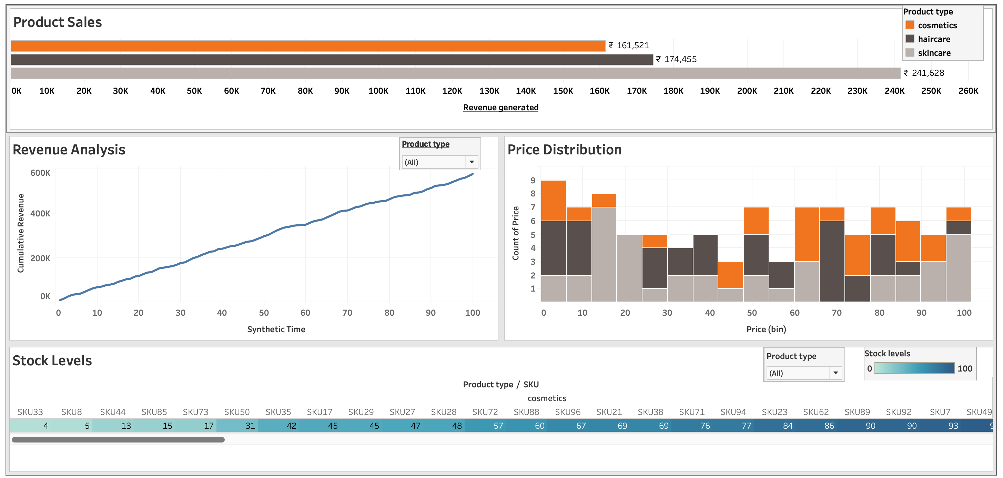
EDA with Data Visualisation
Dashboards used to make Story – Page - 1

Slide 87
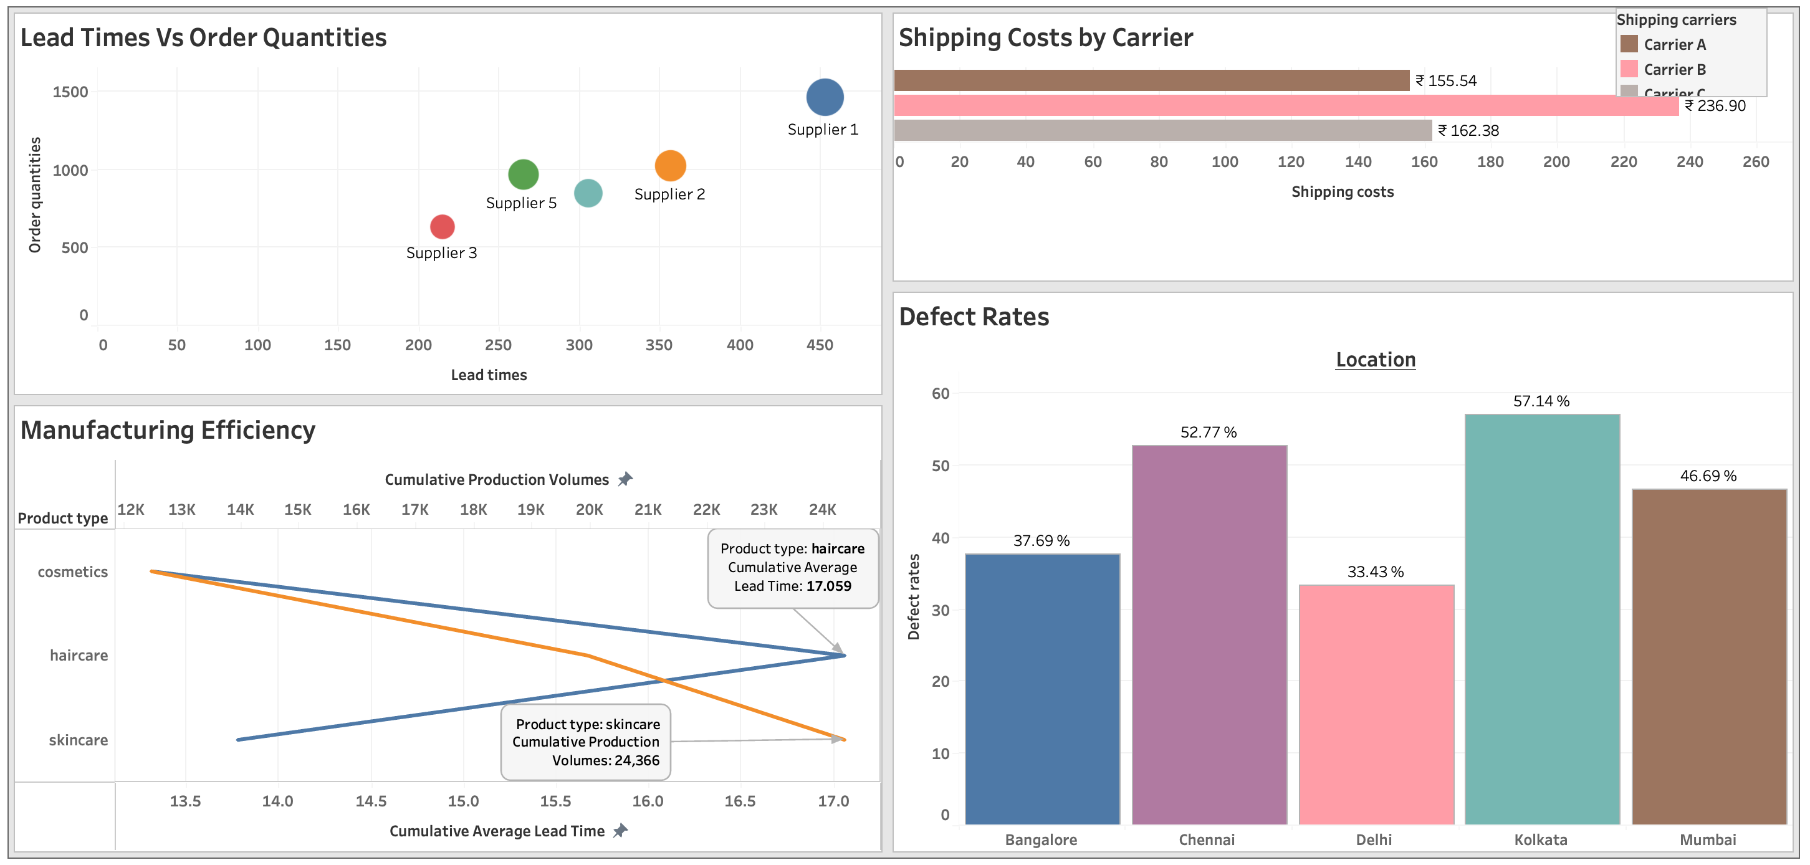
EDA with Data Visualisation
Dashboards used to make Story – Page - 2

Slide 88
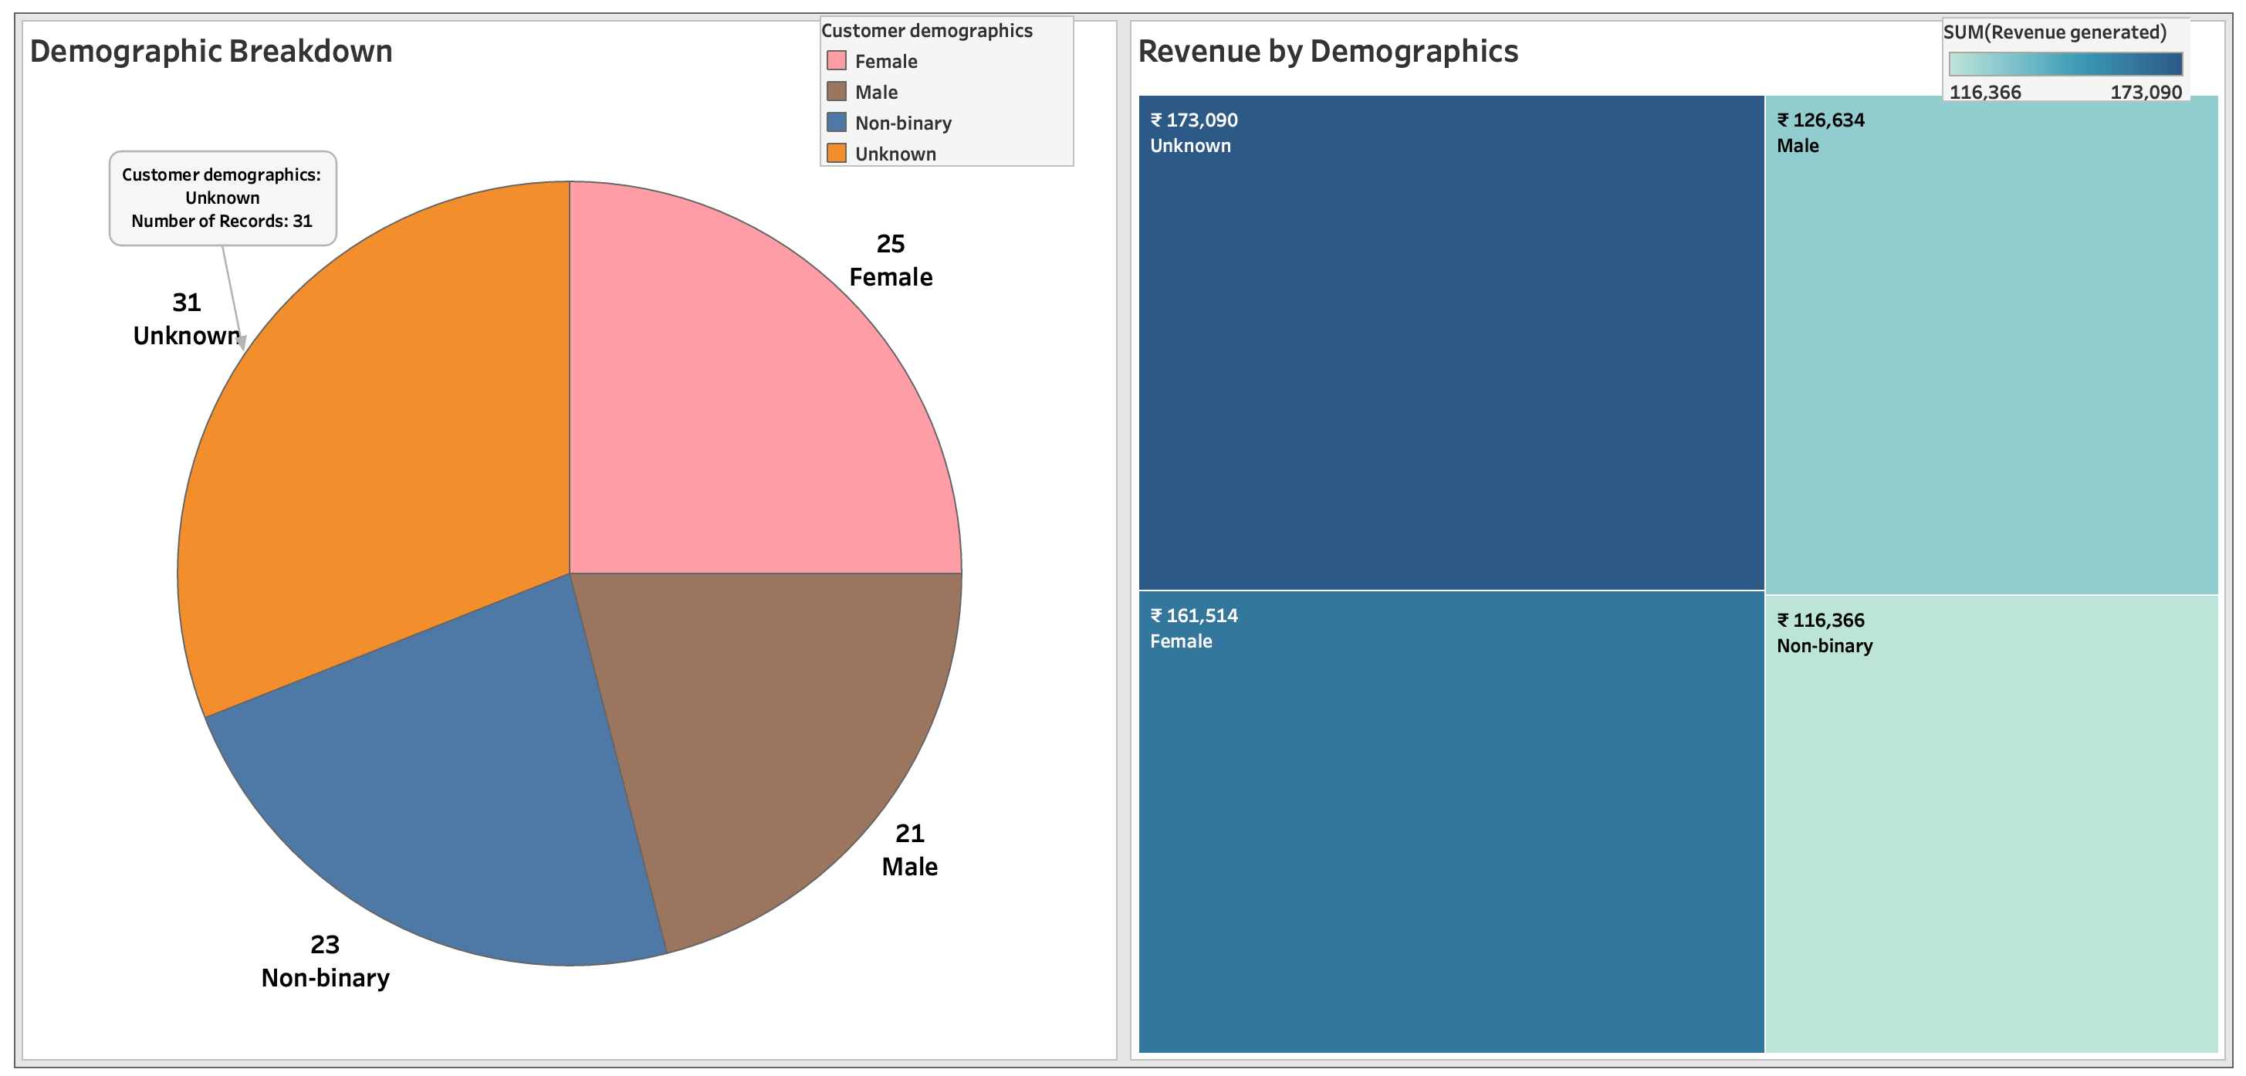
EDA with Data Visualisation
Dashboards used to make Story – Page - 3

Slide 89
Section 2

Slide 90
Results
Exploratory data analysis results
Using Exploratory Data Analysis the analysis of Product Performance and Supply Chain Efficiency is done.
Story – Page - 1
>> The Bar chart of Product sales shows ‘skincare’ as the product having the highest sales revenue of ₹ 241,628 and the next being ’haircare’ with sales revenue of ₹ 174,455, the sales revenue of ‘cosmetics’ is ₹ 161521.
>> The line chart of product-wise as-well-as overall revenue analysis depicts an almost 45% line leading to the conclusion that over a period the sales revenue has been increasing consistently.
>> The Bar chart of Price Distribution shows ‘skincare’ as the product having the highest product sales in the price range ₹ 10 to ₹ 20 and ₹ 90 to ₹ 100 while that of ‘haircare’ it is ₹ 65 to ₹ 80 and that of ‘cosmetics it is ₹ 0 to ₹ 5, ₹ 60, and ₹ 70 to ₹ 85.
>> The granular product-wise heat map for stock levels depicts the granular stock levels of each category of product and can be understood based on the visualization of the intensity of the colour.
Story – Page - 2
>> The Scatter plot of Lead times Vs Order quantities depicts that the Supplier 1 has the highest lead time and Order quantities while the Supplier 3 has the lowest lead times and Order quantities.

Slide 91
Results
Exploratory data analysis results
Story – Page – 2 contd/-
>> The Bar chart of Shipping costs by Carrier depicts that Carrier B has the highest shipping cost of ₹ 236.90 while Carrier C has a shipping cost of ₹ 162.38 and the Carrier A has the lowest shipping cost of ₹ 155.54.
>> The Dual Axis chart prepared for Manufacturing Efficiency shows the relation of Product Types to Production Volumes and Lead Times.
>> The Bar chart of defect rates location-wise shows that the highest defect rates of 57.14% is at the location Kolkata while the lowest defect rates of 33.43% is at the location Delhi.
Story – Page – 3
>> The Pie chart of Demographic breakdown shows the Customer demographics “Unknown” having the largest value of 31 and another category ‘Non-binary’ having a value of 23. As these two categories constitute together constitute 54% of the total these were shown as separate categories. The reason for showing it as such is explained in detail in Appendix – 1. For the remaining categories Female with 25 and Male with 21 constitutes 46% of the demographic distribution.
>> The Tree map of Revenue by Demographics shows the revenue under different demographic categories as “Unknown” ₹ 173090, “Female” ₹ 161514, “Male” ₹ 126634, and “Non-binary” ₹ 116366, in the decreasing order.

Slide 92
Section 3

Slide 93
Conclusions
At the beginning of the project, we defined the tasks that were to be performed.
Task - 1
Dataset Preparation:
>> Ensure that your dataset contains all the columns mentioned: Product Type, SKU, Price, Availability, Number of products sold, Revenue generated, Customer demographics, Stock levels, Lead times, Order quantities, Shipping times, Shipping carriers, Shipping costs, Supplier name, Location, Lead time, Production volumes, Manufacturing lead time, Manufacturing costs, Inspection results, Defect rates, Transportation modes, Routes, Costs.
Answer:
Using SQLite in DBeaver the CSV data file was analysed and it was ensured that the data set contains all the columns mentioned.

Slide 94
Conclusions
Task - 2
Create the following visualizations:
2.1. Product Performance Dashboard
2.2. Supply Chain Efficiency Dashboard
2.3. Customer Demographics
Answer:
All the three dashboards were prepared and the images have been included on to the slides in this presentation.
The Tableau PublicLink of the work is
https://public.tableau.com/views/SupplyChainManagementDashboardWorkbook/Story1?:language=en-GB&:sid=&:redirect=auth&:display_count=n&:origin=viz_share_link
Task - 3
3.1. Analysis Questions:
Which Product Type generates the highest revenue ?
Answer:
Skincare is the product having the highest sales revenue of ₹ 241,628

Slide 95
Conclusions
Task - 3
3.1. Analysis Questions: contd/-
b) Are there any significant correlations between Lead times and Order quantities ?
Answer:
On drawing a trend-line we observe that the points in the scatter plot are very near to the trend line which is almost having 45% gradient from which we can conclude that there is significant correlation between Lead times and Order quantities as with increase in Order quantities the Lead times also increases.
c) How do Shipping costs vary by Shipping carrier and Location ?
Answer:
Yes, the shipping costs vary by Shipping carrier and Location. Carrier B has the highest shipping cost of ₹ 236.90 while Carrier C has a shipping cost of ₹ 162.38 and the Carrier A has the lowest shipping cost of ₹ 155.54.
Location-wise the shipping costs varies; the highest shipping cost is of Carrier B for Kolkata location of ₹ 66.09 and the lowest is of Carrier C for Bangalore location of ₹ 17.27. For Carrier A the highest shipping cost is for Bangalore of ₹ 39.66 and lowest is for Delhi of ₹ 25.33. For Carrier B the highest shipping cost is for Kolkata of ₹ 66.09 and lowest is for Chennai of ₹ 28.01. For Carrier C the highest shipping cost is for Kolkata of ₹ 50.29 and lowest is for Bangalore of ₹ 17.27.

Slide 96
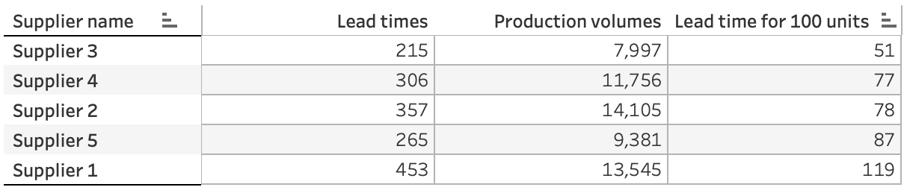
Conclusions
Task - 3
3.1. Analysis Questions: contd/-
d) Which suppliers have the most efficient manufacturing processes based on Manufacturing lead time and Production volumes ?
Answer:
In the manufacturing efficiency chart showing the Supplier-wise Lead times line and Supplier-wise Production volume line which we created using using Dual Axis chart, we can look for the apparent gap between the two lines, however, a better way to find out the supplier having the most efficient manufacturing process is to created a calculated filed for “lead time for 100 units’ and find out the supplier with the lowest value. This we can do using the text table which depicts as below :
We find that in case of supplier 3 the lead time for 100 units is the lowest at 51, so we can conclude that Supplier 3 has the most efficient manufacturing process.
e) What demographic group contributes the most to sales ?
Answer:
We have created a Tree map of Revenue by Demographics showing the revenue under different demographic categories as “Unknown” ₹ 173090, “Female” ₹ 161514, “Male” ₹ 126634, and “Non-binary” ₹ 116366, in the decreasing order. Therefore, the group ‘Unknown’ contributes the most to sales.

Slide 97
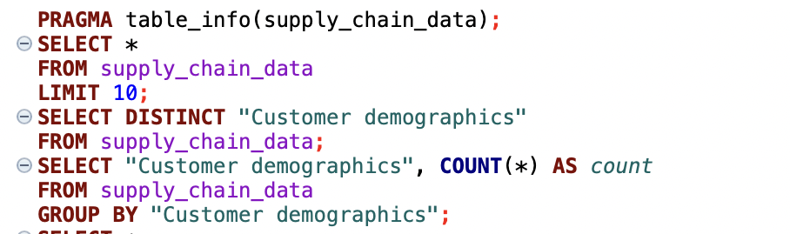
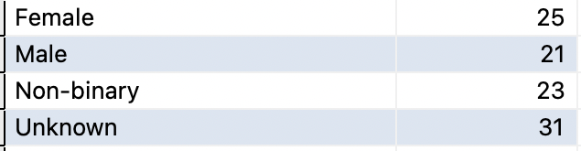
Appendix - 1
In Data Wrangling Step, using SQLite in DBeaver the following queries were run and the sample output is as under :
The Fields were also examined, the fields with their details and the steps taken post analysis are :
Field Name Sample Data Type ‘0’ / null / blank
'Product Type', haircare VARCHAR(50) NIL
‘SKU', SKU0 VARCHAR(50) NIL
'Price', 69.80800554211577 REAL NIL
'Availability', 55 INTEGER NIL

Slide 98
Appendix - 1
The Fields were also examined, the fields with their details and the steps taken post analysis are :
contd/-
Field Name Sample Data Type ‘0’ / null / blank
'Number of products sold', 803 INTEGER NIL
'Revenue generated', 8661.996792392383 REAL NIL
'Customer demographics', Non-binary / Male / VARCHAR(50) NIL
Female / Unknown
'Stock levels', 58 INTEGER NIL
'Lead times', 7 INTEGER NIL
'Order quantities', 96 INTEGER NIL
'Shipping times', 4 INTEGER NIL
'Shipping carriers', Carrier B VARCHAR(50) NIL
'Shipping costs', 2.956572139430807 REAL NIL
'Supplier name', Supplier 3 VARCHAR(50) NIL
'Location', Mumbai VARCHAR(50) NIL
'Lead time', 23 INTEGER NIL
'Production volumes', 215 INTEGER NIL
'Manufacturing lead time', 29 INTEGER NIL

Slide 99
Appendix - 1
The Fields were also examined, the fields with their details and the steps taken post analysis are : contd/-
Field Name Sample Data Type ‘0’ / null / blan
'Manufacturing costs', 46.27987924050832 REAL NIL
'Inspection results', Pending / Fail VARCHAR(50) NIL
'Defect rates', 0.22641036084992516 REAL NIL
'Transportation modes', Road / Air / Rail / Sea VARCHAR(50) NIL
'Routes', Route B VARCHAR(50) NIL
'Costs'. 187.75207545920392 REAL NIL
On analysis of the data we find that the numbers of different values in ‘Customer demographics’ field as Female = 25, Male = 21, Non-binary = 23, Unknown = 31 i.e. Unknown and Non-binary being 23% and 31% respectively. Given that more than 50% of the data is either "Non-binary" or "Unknown," we should not discard them. The choice between merging them into a broader category like "Other/Unspecified" or redistributing them proportionally to "Male" and "Female" depends on our analysis goals:

Slide 100
Appendix - 1
The Fields were also examined, the fields with their details and the steps taken post analysis are : contd/-
If simplicity and clarity are important, merging into "Other/Unspecified" might be a good approach.
If we want to work with the data in its most detailed form, we can keep them as separate categories and report the findings accordingly.
As we feel that removing or replacing these values could bias the analysis, we have retained them and have handled the visualization in Tableau:
In Tableau, we have created a separate category for "Non-binary" and "Unknown" but have highlighted that these may represent unknown or alternative gender identities.
This could give us a more inclusive and informative analysis.
Thus, after examining the dataset (csv file) using SQLite we have concluded that no such data wrangling is, required and the csv file can be uploaded into Tableau for preparation of Charts and making the story.

Slide 101
THANK YOU

